Slide 1
Understanding
Subjective Well-being and
Stress at Work

Slide 2
Contents
Part 1: Neurodiversity and Mental Health Needs
Part 2: Understanding Subjective Well-Being at work
Part 3: Legal issues surrounding neurodiversity
in the workplace
Part 4: Reflection
Part 5: Planning next steps

Slide 3
Part 1: Neurodiversity and Mental Health

Slide 4
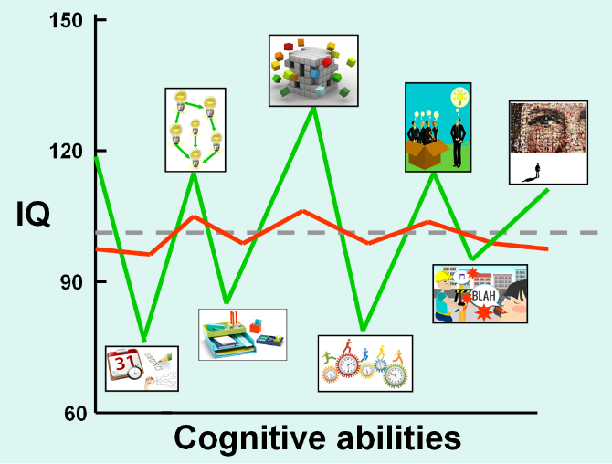
Neurodiverse people have abilities which are ‘out of balance’, with significant differences between their strengths and difficulties.
Neurotypical individuals (red line) have similar abilities in all areas.

Slide 5
Recent research has grouped these neurodiverse conditions into four key categories:
From Psychology at work: Improving wellbeing and productivity in the workplace, Weinberg, A & Doyle, N, 2017.

Slide 6
Mental Health needs: Common Strengths & Difficulties
 | Difficulty | Strength
37% of sickness absence | ‘Executive functions’, which means memory, attention, planning, inhibitory control and decision making Stigma around disclosure and low expectations Demands of work leading to unmanageable stress | Creativity Ability to ruminate and think deeply

Slide 7
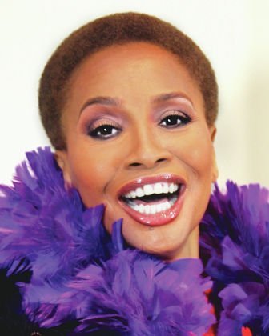
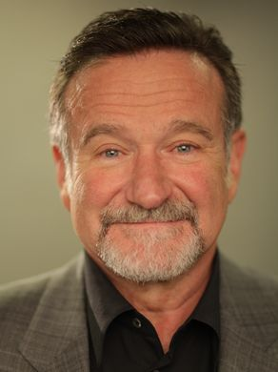
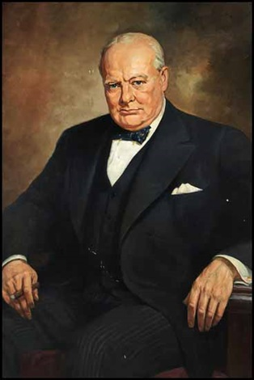
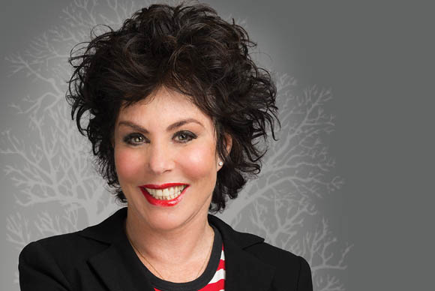
Well-known people who have Mental Health Needs
Robin Williams
Jenifer Lewis
Winston Churchill
Carrie Fisher
Ruby Wax

Slide 8
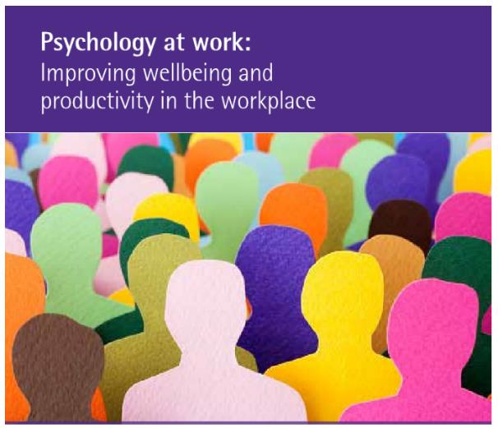
https://www.bps.org.uk/sites/beta.bps.org.uk/files/Policy%20-%20Files/Psychology%20at%20work%20-%20improving%20wellbeing%20and%20productivity%20in%20the%20workplace.pdf

Slide 9
Getting Support
Getting a workplace needs assessment (free through Access to work or some choose full private assessment). This will give advice on:
Assistive technology
Coaching
Informal adjustments
Use a free online tool to find out your strengths and difficulties and strategies that might work for you. We have a free strategy profiler on our website: https://screening.geniuswithin.co.uk/index.php/dyslexiatest/indexhttps://screening.geniuswithin.co.uk/index.php/dyslexiatest/index
https://www.gov.uk/access-to-work

Slide 10
Part 2: Understanding
Subjective Well-Being

Slide 11
A Bio-Psycho-Social Model of Subjective Well-Being
Neuro-cognitive factors & predispositions
Interpersonal interactions and immediate relationships
Organisational, cultural & political context
Person Factors
Environmental Factors

Slide 12
Workplace theories of well-being and motivation (Weinberg, 2017)
 | Meaning of work | Rewards via working | Prevent psychological harm | Person or Environment Factors | Model outline highlighting key components in relation to employee well-being
Job Characteristics Model (JCM)ᵃ | X | X | X | E | Considers five factors of the work environment – autonomy, skill variety, feedback, task identity and significance – and how they are linked to employees’ psychological growth needs, which include meaningfulness, responsibility and knowledge of results
Job demands-Job control (JDC)ᵇ |  | X | X | E | Focuses on the additional or interactive impact of varying levels of work demands and discretion over one’s job
Job Demands- Control - Supportᶜ |  |  |  | E&P | Expands on the above to take into account the potential for social support at work to buffer the effects of work demands and low control.
Warr’s Vitamin Modelᵈ | X | X | X | E (updated to E/P) | Outlines the contribution of 12 work features (see main text above) including some which should be at optimal levels for our well-being (e.g. control) and some which are positively correlated (e.g. pay)
Job demands-resources (JD-R)ᵉ | X |  | X | E/P | Both demands and resources experienced by the employee interact so that ‘different job resources,[such as control and social support] can play the role of buffer for several different job demands’ᵉ (p.314)
Person-Environment fitᶠ |  | X | X | E/P | There is a good ‘fit’ between the person’s values, attributes and skills and the resources and demands in their work environment
Effort-Reward Imbalance (ERI)ᶢ | X | X | X | P | A combination of high levels of effort and low rewards results in imbalance leading to negative health outcomes.
Conservation of Resources (COR)ᴶ | X | X | X | P | Individuals strive to retain, protect, and build resources to ‘insure’ ourselves against the threat, or impending loss, of valued resources
Affective Events Theoryᵏ | X |  |  | P | Appraisal of threat and our resulting emotions play a key role in activating our responses to work situations. Through learned associations, emotions can influence our attitudes and behaviour
Job Craftingᵐ | X | X | X | P | Employees modify aspects of the work environment to increase available structural or social resources, or increase the level of challenge experienced at work to facilitate fulfilment

Slide 13
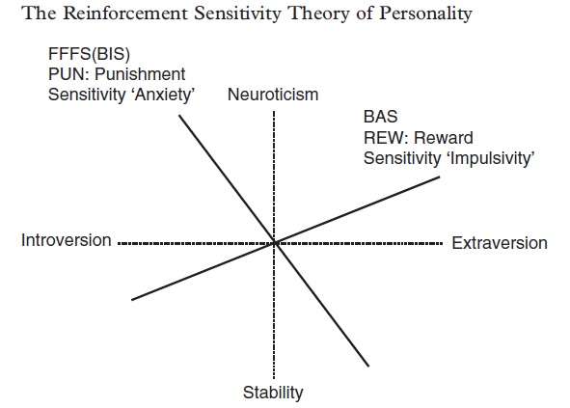
Personality and SWB
Gray (1970s) revised Corr, McNaughton (2000s)
Building on Eysenck’s Extraversion/Neuroticism scale
Ascending Reticular Activating System – lower response thresholds

Slide 14
Demand Control model of Stress (Karasek, 1990)
High Control Low Control
High Demand
Low Demand

Slide 15
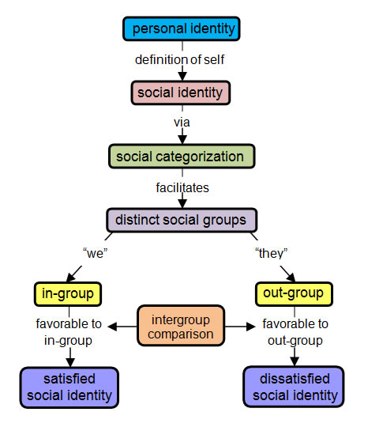
Social Identity Theory (Tajfel and Turner)

Slide 16
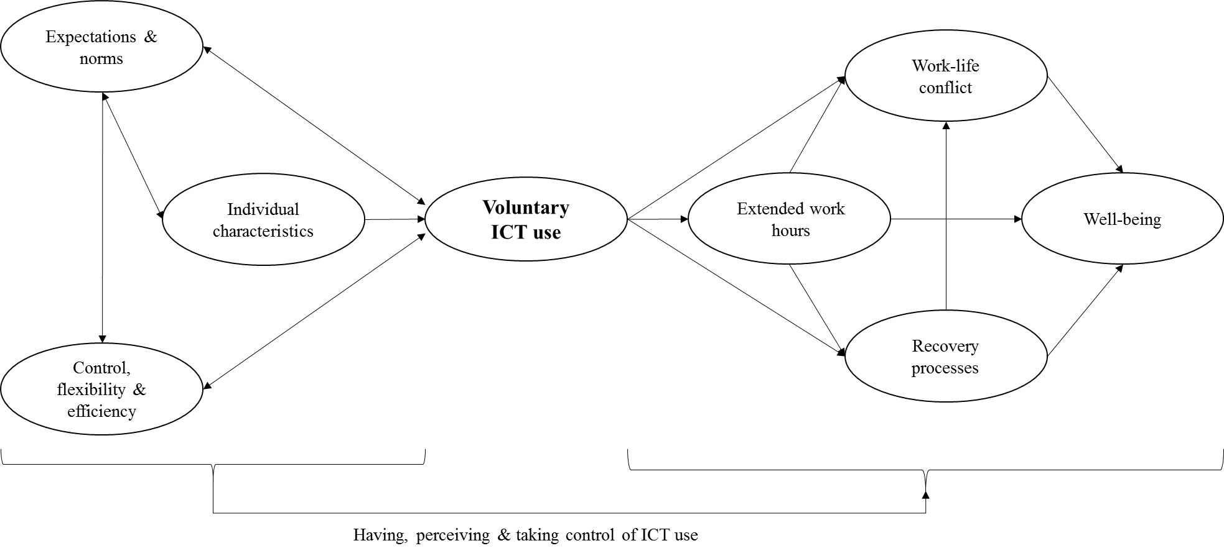
Always ‘on’ Culture: Empowerment Enslavement Paradox
See Venkatesh, Sonnetag, Wacjman, McDowall, Schlacter for further analysis

Slide 17
Sleep Hygiene! Routine and….
Blue screen
Perlow, L.A. (2012). Sleeping with your smartphone: How to break the 24/7 habit and change the way you work. Boston, MA: Harvard Business Review Press.
Boundaries
Querstret, D. and Cropley, M. (2012). Exploring the relationship between work-related rumination, sleep quality, and work-related fatigue. Journal of Occupational Health Psychology, 17, pp. 341-353.

Slide 18
Part 3: The Legal Issues Surrounding Neurodiversity in the Workplace

Slide 19
What are the legal issues surrounding neurodiversity in the workplace?
“A person has a disability if she or he has a physical or mental impairment that has substantial and long term (12 months+) adverse effect on his or her ability to carry out normal day-to-day activities.”
Equality Act 2010

Slide 20
Mental Injury rather than mental illness:
A paradigm shift removing victim blaming
We know which environments and practices lead to work stress
We know how to buffer and ameliorate these
When we don’t do it we are then culpable of injury, same as failing to remove asbestos or protecting workers from cigarette smoke
https://www.healthandsafetyatwork.com/mental-injury

Slide 21
NICE (2015) recommendations for management practices
Management Practices | Recommendation examples for management
Organisational commitment | Managers – including senior level – to proactively support health and well-being of employees
Physical work environment | Meet statutory requirements for safety
Mental wellbeing at work | Promote psychological safety climate – referencing HSE stress management standards
Fairness and justice | Ensure equality of access to sources of support
Participation and trust | Value the contributions and voice of employees
Senior leadership | Role model behaviours and policies which prioritise employee health and well-being
Role of line managers | Act as a two-way communication channel between the employee and the organisation
Leadership style of line managers | Consultative and positive approach
Training | Update, support and tailor to needs
Job design | Encourage flexibility and enhanced control
Monitoring and evaluation | Appropriate measurement of impact

Slide 22
1. All employers to proactively seek to improve employee wellbeing by developing well-designed jobs, monitoring them and seeking to increase employee engagement.
As a minimum this includes implementing the relevant guidance from NICE and HSE on improving psychological wellbeing at work, which helps employers to apply the psychological principles outlined above in a practical way.
2. Employers, and particularly those who employ people on zero hours contracts, to maintain transparent two-way communication with their employees and offer effective support and so that they can carefully consider the psychological impact of atypical work arrangements and job insecurity.
Employers actively design workplace practices to protect their employees’ wellbeing and ameliorate the negative effects of insecurity.
3. Senior managers to regularly discuss employee health and wellbeing at board level to ensure a proactive approach to mental wellbeing at work, and include employees in a collaborative way to find solutions.
A culture of preventing psychological harm starts at the top of an organisation but involves people at every level.
4. Organisations to recognise the behaviours of managers which will help to minimise stress-related problems, i.e. fostering positive supervisory behaviours and enhancing managers’ capacity to identify and act on symptoms of poor psychological health among employees.
Toolkits and self-assessment processes developed by HSE/CIPD and initiatives such as the Workplace Wellbeing Charter can used to support organisations.

Slide 23
Supporting Individuals with Mental Health
Needs or Injuries
Medical
Keep in contact with medical professionals, support with sleep and mood might be necessary
Strategies
Memory skills
Ergonomics
Know your emotional triggers – position yourself where you can feel calm and not overwhelmed
Pay attention to diet and rest
Keep an exercise and rest balance
Organisational skills – lists and colour are a great help
Timekeeping
Self-advocacy
Ask for clarification and examples
Work to strengths
Create a breaks routine and keep to it
Identify break out spaces for moments of overwhelm

Slide 24
Supporting Individuals with Mental Health
Needs or Mental Injuries
Communication
Meetings
Give extra time before and after to review materials where possible
Awareness
Allow the individual to have break out space and don’t interrupt when this is being use unless invited and pre-agreed
Give alternative to group meetings – update via 1:1
Follow up requests in meetings with written emails or notes
Give agenda to every meeting, identify and acknowledge when deviating from it
Listen to the individual, ask them what they would like to have happen
Notice that you might spend extra time de-briefing interactions or reassuring people. This might seem laborious, but consider if you would mind spending a few extra minutes helping someone with a visual impairment walk through a new room layout to familiarise themselves with the space. Time spent de-briefing is no different to that.
Provide a buddy of mentor if possible
Stress Monitoring Apps

Slide 25
We are all different ….
…. so the best support is individualised.

Slide 26
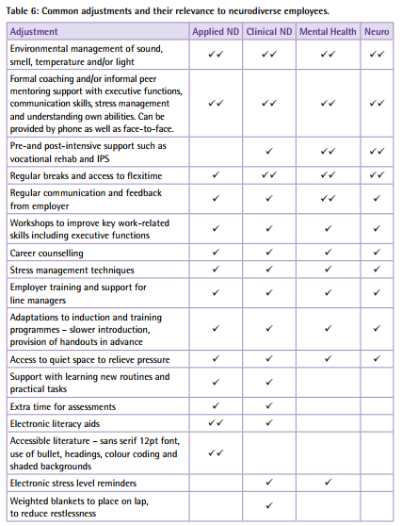
Common Adjustments and their relevance to neurodiverse employees
From Psychology at work: Improving wellbeing and productivity in the workplace, Weinberg, A & Doyle, N, 2017.

Slide 27
Part 4: Reflection

Slide 28
REFLECTION
1. What are you doing well to make your workplace inclusive
for neurodiverse individuals?
What do you see and hear to know this?
2. What are you not doing so well?
What do you see and hear to know this?
3. What could you do better?
What will you see and hear when you have achieved this?

Slide 29
Part 5: Planning next steps

Slide 30
A social enterprise supporting people with neurodiverse conditions.
PLANNING NEXT STEPS
What three things can you do now that will make your
workplace more inclusive?
What could you do more of?
What could you do less of?
What could you do differently?

Slide 31
A social enterprise supporting people with neurodiverse conditions.
https://www.geniuswithin.co.uk

Slide 32
For more information, contact:
Email: office@geniuswithin.co.uk
Tel: 01273 890502
Or visit our website: https://www.geniuswithin.co.uk

