Slide 1
Applying to Public Health Training
Amy Li ST3
Pankhuri Sahare ST4

Slide 2
TABLE OF CONTENTS
01
Essential Criteria
02
Oriel
03
Assessment Centre
04
Selection Centre
05
Ranking

Slide 3
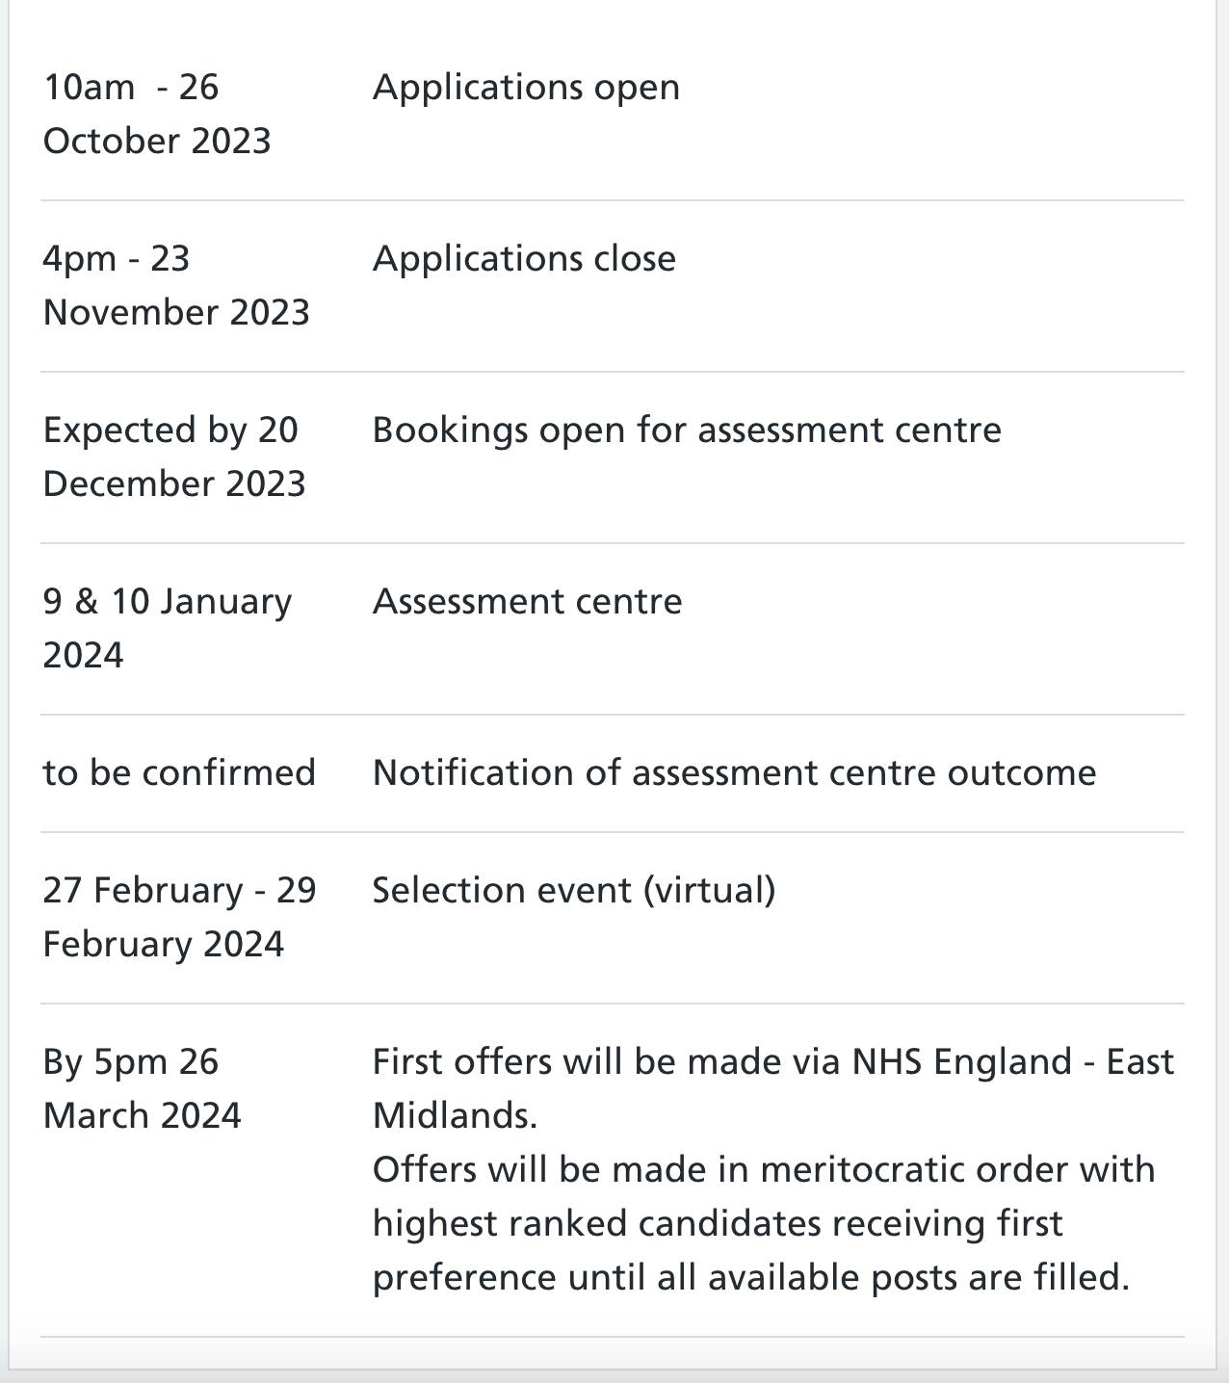
Important Dates
https://medical.hee.nhs.uk/medical-training-recruitment/medical-specialty-training/public-health/recruitment-information

Slide 4
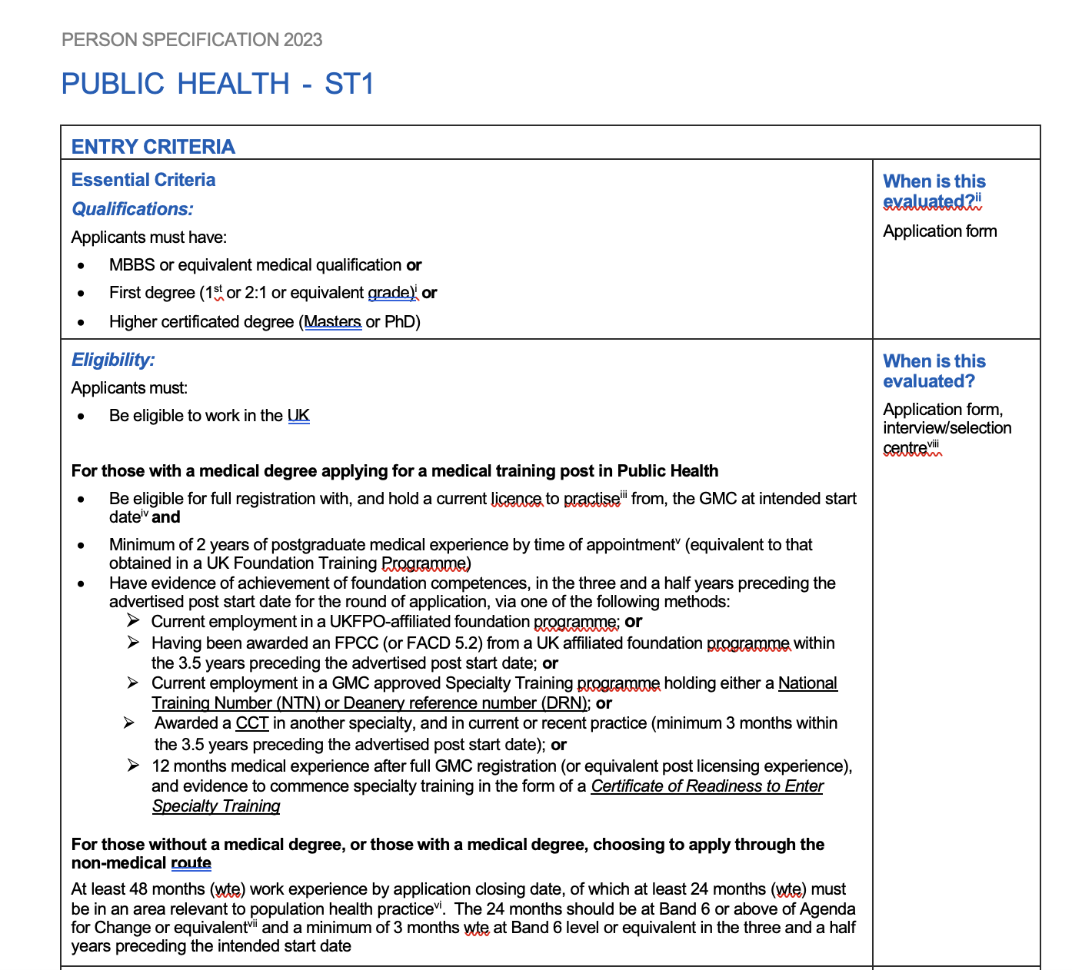
Person Specification
Person Specifications 2025 | Medical Hub
Public Health ST1 2025 | Medical Hub
Notes:
Finish F2 in August 2024
3.5 years = February 2028
To start in August 2027 you must apply in November 2026

Slide 5
Applying on Oriel

Slide 6
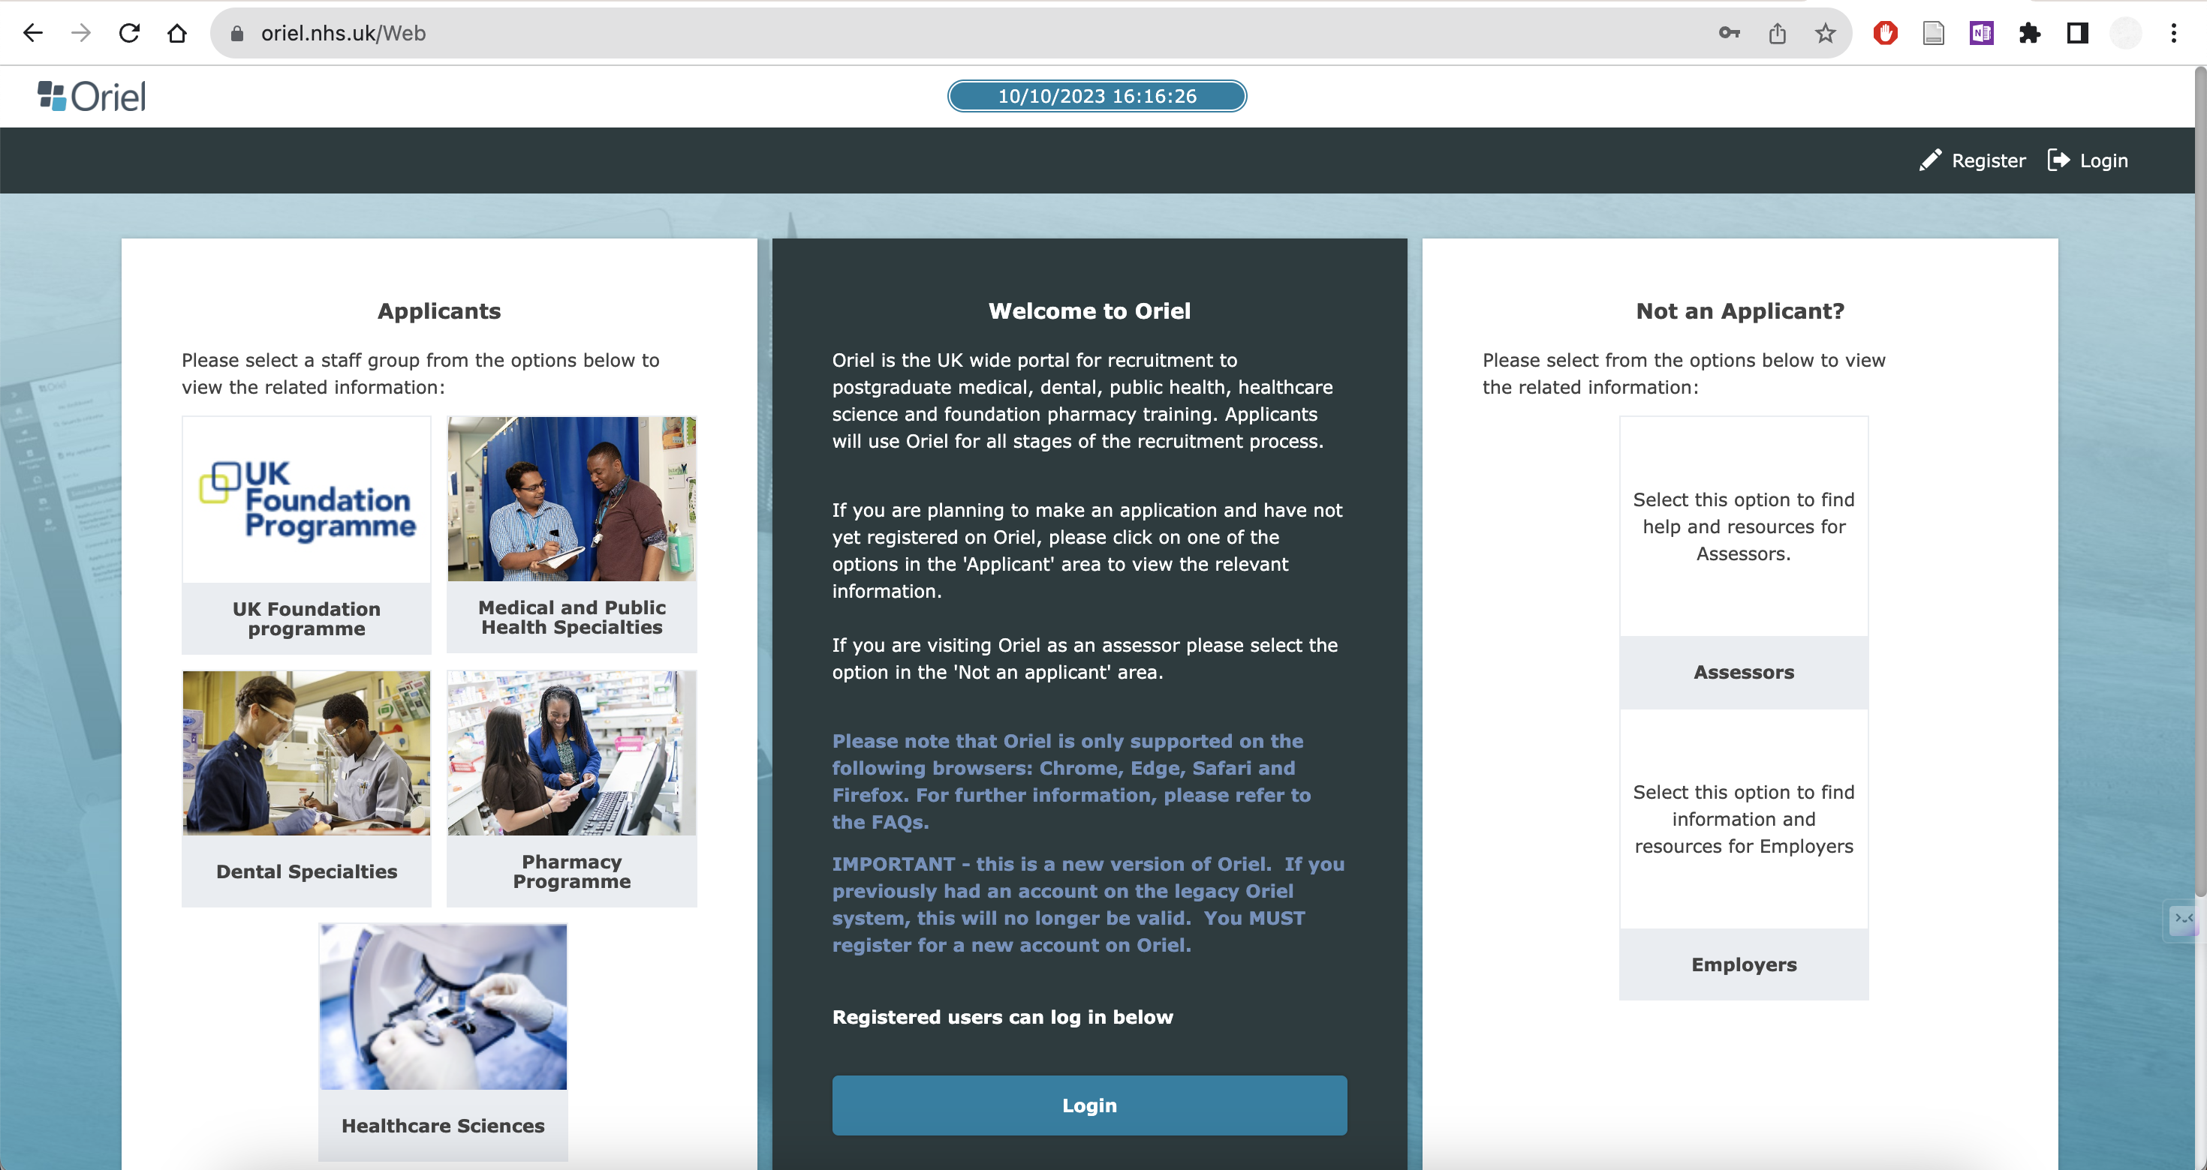

Slide 7
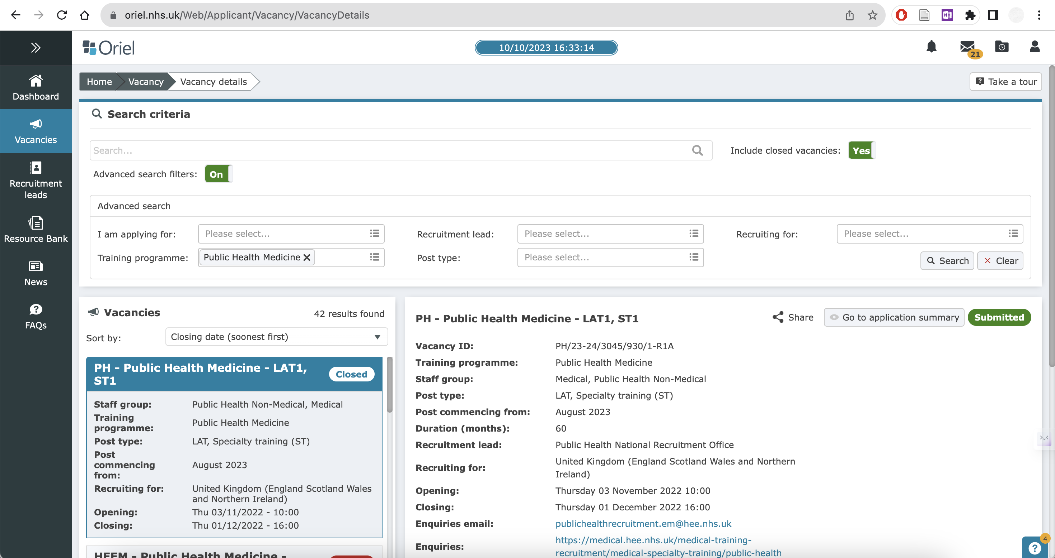
https://medical.hee.nhs.uk/medical-training-recruitment/medical-specialty-training/public-health/recruitment-information/applying-in-oriel

Slide 8
Assessment Centre
Online aptitude test
Usually in-person at Pearson Vue
No alternative dates
Adjustments available
3 online tests in the same sitting
All multiple choice
Watson – Glaser Critical Thinking Appraisal - 30 minutes (40 questions)
RANRA – Rust Advanced Numerical Reasoning Appraisal - 40 minutes (32 questions)
A Public Health-specific Situational Judgement Test - 100 minutes (53 questions)
45 seconds
75 seconds
1 min 53 seconds
Public Health Assessment Centre | Medical Hub
Recruitment Information | Medical Hub
Notes:
- Applicants will need to reach a minimum standard at the tests of numeracy and critical reasoning and the situational judgment test. Applicants meeting this standard will then be ranked according to their scores at assessment. Applicants failing to meet the minimum standard at assessment centre will be notified at this stage that their application will not proceed further.

Slide 9
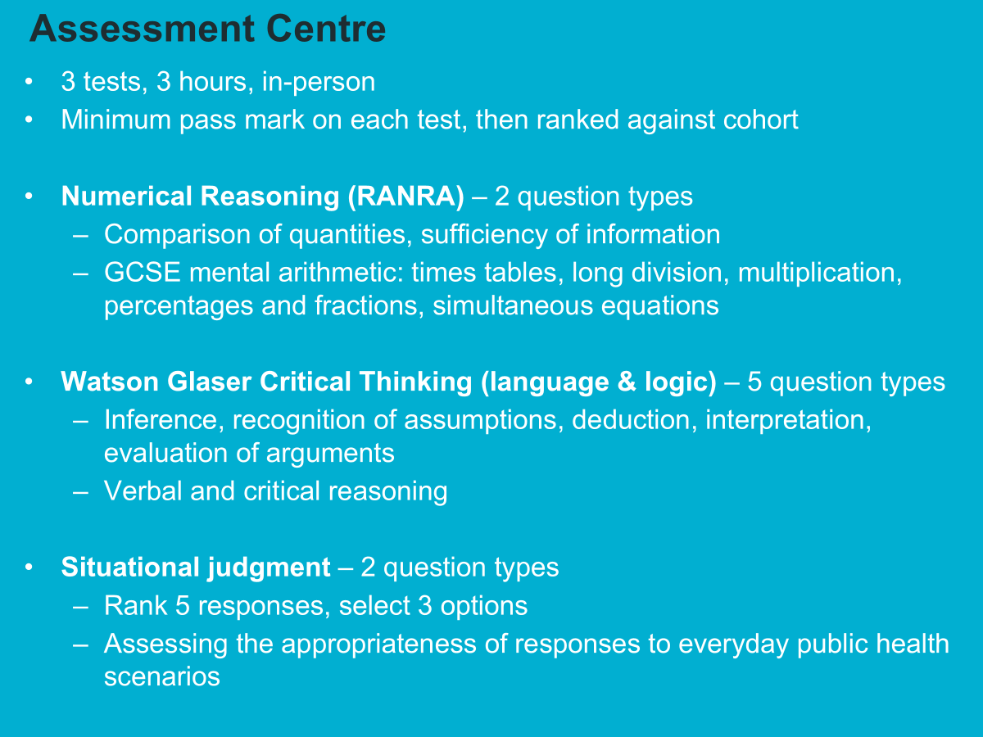

Slide 10
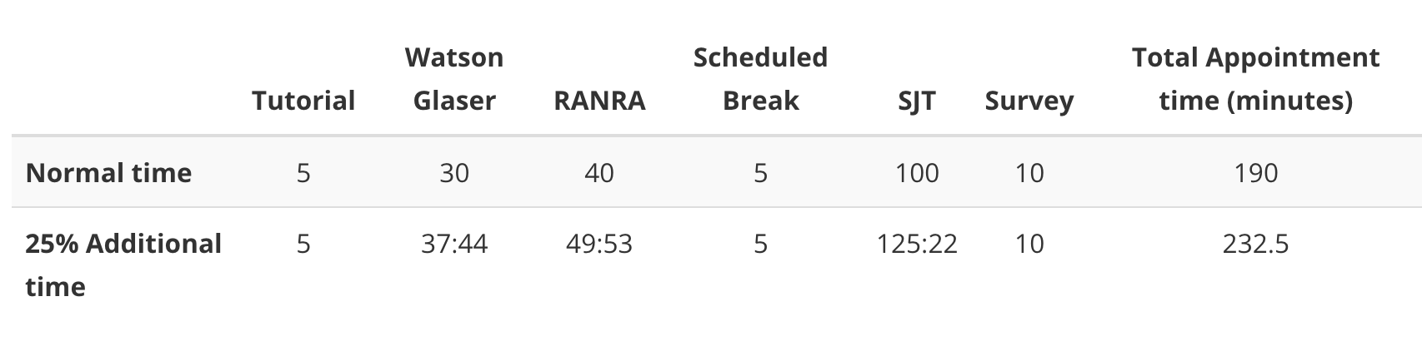

Slide 11
Selection Centre
Virtual online interviews
Fixed days
Usually between 200-300 slots
6 questions x 6 minutes
2 interview stations - 3 questions in each.
3 assessors in each station
Two questions will need preparation. The information will be sent to you the day before your interview.
Interviewers will not introduce themselves. You will be cut off at the time limit.
You must reach the minimum total score set for the selection centre to be deemed “appointable”.
Recruitment Information | Medical Hub
Notes:
Top ranked applicants from the written tests will be invited to a virtual selection centre process

Slide 12
Note on Ranking Locations
Invited to rank placements before interview
You can mix and match within deaneries
Only rank places you would be happy to move to
The ones you don’t rank – you won’t be considered for at all.
First allocation is not final, may be promoted throughout process as others withdraw or are promoted
You will move placements as a trainee within the region

Slide 13
Competition Ratio
Competition ratios | Medical Hub
 | 2018 | 2019 | 2020 | 2021 | 2022 | 2023
Applications | 754 | 804 | 933 | 988 | 1085 | 1258
Posts | 78 | 86 | 77 | 98 | 95 | 124
Competition ratio | 9.67 | 9.35 | 12.12 | 10.08 | 11.42 | 10.15

Slide 14
Takeaways
If you don’t apply you won’t be able to sit the assessment centre
If you don’t pass the assessment centre you won’t be shortlisted for interview
If you get an interview you are much more likely to get a post
Being selective with ranking means you may miss out on a post but if you rank a location you do not want it may be the only offer you get.
Practice Practice Practice!
Read all the available resources and the questions!

