Slide 1
APPLYING TO PUBLIC HEALTH
Our Perspectives!
Dr Katie Selfe and Dr Pallavi Govind
Notes:
Katie

Slide 2
Our background
Katie
Pallavi
Graduated from Oxford 2020
Essex FY1/FY2
Hertfordshire GPST1/ST2
→ moved jobs
Currently PH ST2 at Derby City Council
Graduated Imperial College London 2021
London FY1/FY2
London CST1 → quit
Then applied for PH EM
Current PH ST2 at Leicestershire County Council
Notes:
Katie and Pallavi

Slide 3



Why Public Health?
Katie
Pallavi
Public health placement as GP trainee
Looking at issues through a wider lens
Felt restricted in GP
Felt restricted in clinical medicine
Always had an interest in PH but on the side
Would miss clinical medicine?
Every specialty has pros and cons
Notes:
Katie and Pallavi

Slide 4


Gaining experience in Public Health can be tricky
As a placement in GP rotation
Not a lot of exposure in medical school
Any qualifications? E.g. Global Health BSc
Any placements?
In your own life?
Any experience can be helpful to frame answers in interview
People’s experience is very variable so don’t worry!
Notes:
Katie and Pallavi

Slide 5
Reflections on the application process
Marathon not a sprint
Preparing application early
Don’t underestimate the assessment centre exam
The assessment centre exam is a short-listing tool for interview
No calculators (so don’t practice with one!)
Interview: technology working, quiet place, dressing smart, check email spam
Notes:
Pallavi

Slide 6

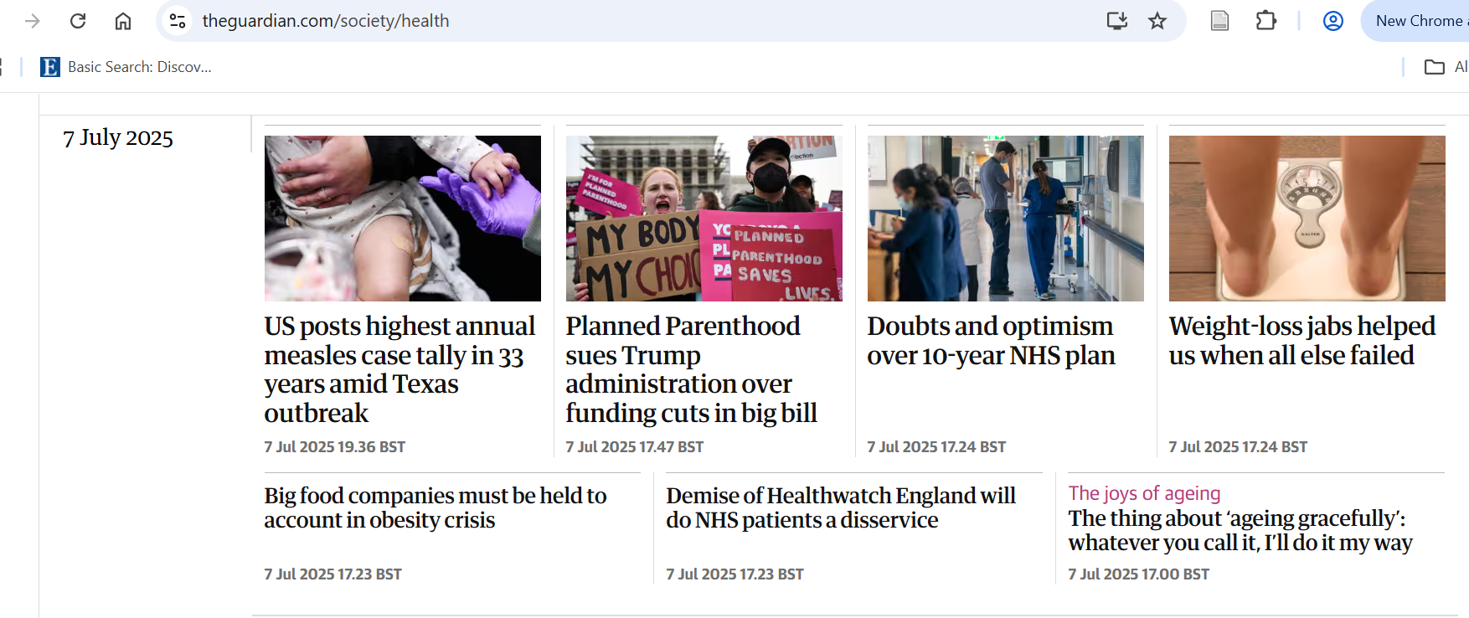

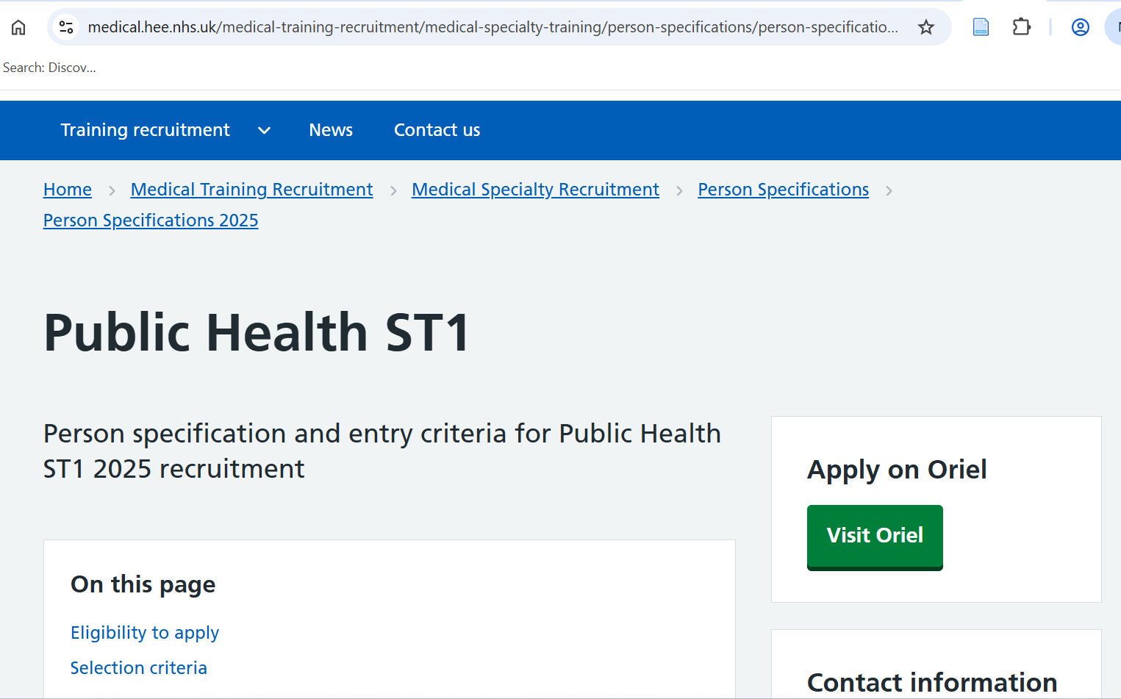
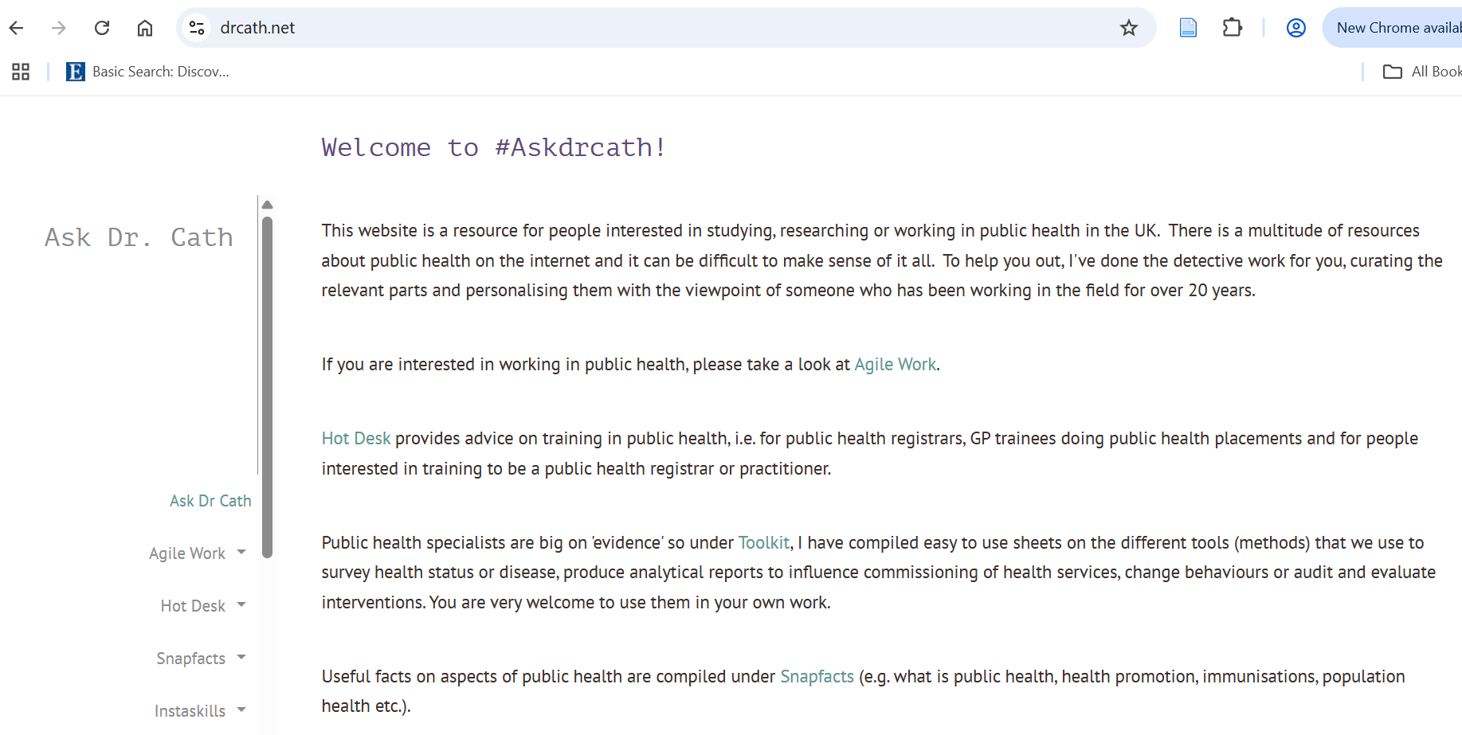
Where can I learn more about Public health?
Notes:
Pallavi
Reading publically available JSNAs, HNAs.

Slide 7


Reflections since starting work
Transition into different style and pace of work from clinical work
You still work with people but in a different way!
Improved work-life balance
Flexible working
Remote working can be challenging
Balancing time with the MPH
Notes:
Katie

Slide 8

Conclusions
It’s a competitive process, don’t be disheartened
Good, fulfilling and supportive career with many opportunities
Lots of opportunities to do what you want locally, nationally or internationally
Good luck with the application!
Notes:
Katie

Slide 9
Thank you
Any questions?

