Slide 1
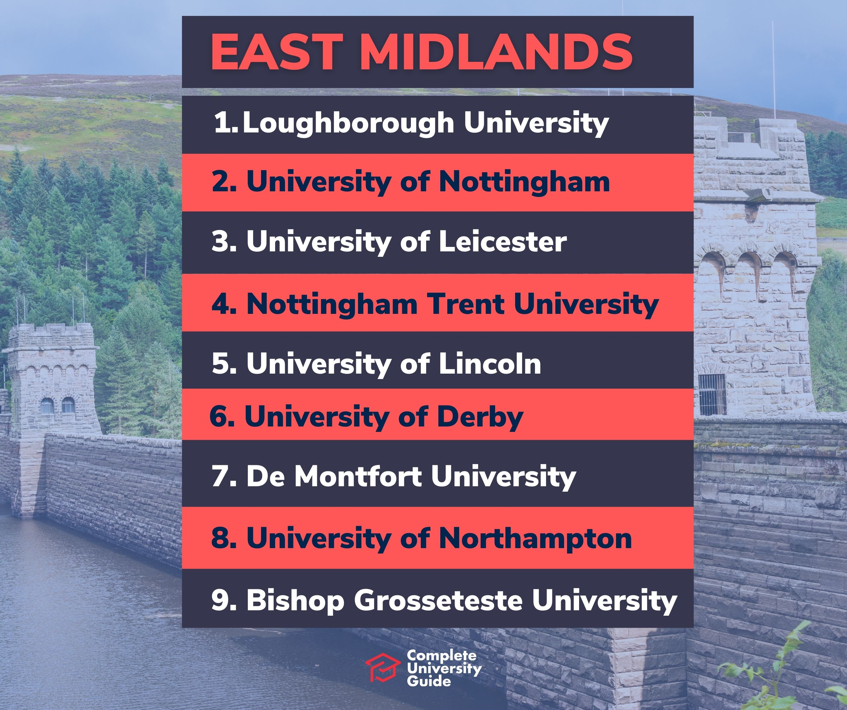

Academia and public health training
Nathan Davies, NIHR Doctoral Fellow and Specialty Registrar in Public Health
University of Nottingham

Slide 2
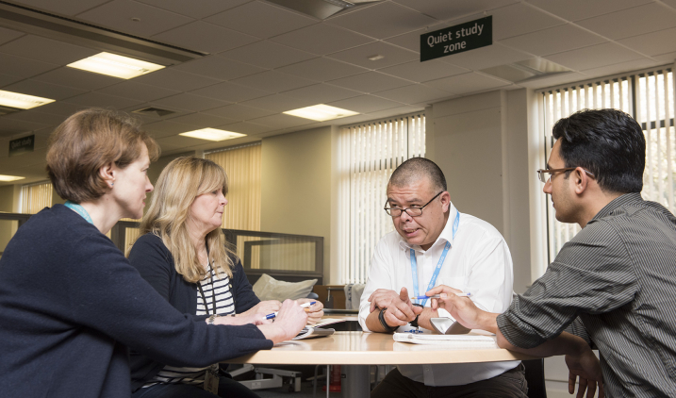
What is public health academia?
Most public health academics spend most of their time doing research and/or teaching and are mostly based at universities
Research is systematically and methodically generating new insights into public health issues
What does this look like?
  Publishing research in peer-reviewed journals
  Applying for grants (as a group, asking for money for research ideas from external bodies) and fellowships (as an individual, asking for money to do research from external bodies)
  Supervising student research & acting as personal tutor
  Teaching students and professionals
  Community/partnership work

Slide 3
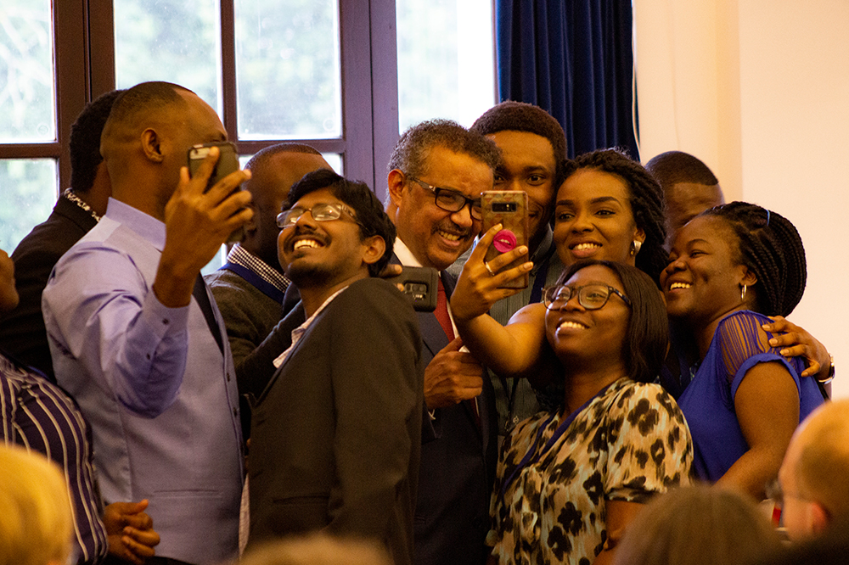
All public health registrars have academic component to training
Complete a Masters in Public Health (MPH) if not already obtained (ST1, first year of training)
Will do a research project/dissertation where you conduct research
One day a week academic time
Delivering teaching (often medical students or MPH)
Academic competencies

Slide 4

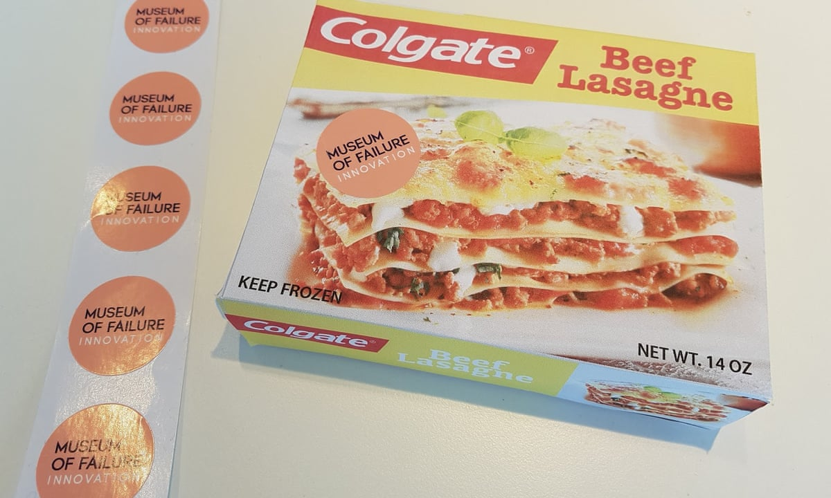
Some public health registrars take up optional extras
Placement at university, thinktank or other research-focused institute
Clinical lecturer role (apply to split time in academia, hosted by university, and in public health practice)
Go “out of programme” to do PhD or other form of research

Slide 5










Incidental research
MPH and dissertation (ST1)
Honorary contract at UoN (ST2-3)
ASH placement and
research (ST3)
Out of programme for PhD
(ST4)
Clinical lecturer (50%) (ST3-ST4)
Notes:
Come from working in local public health,

Slide 6
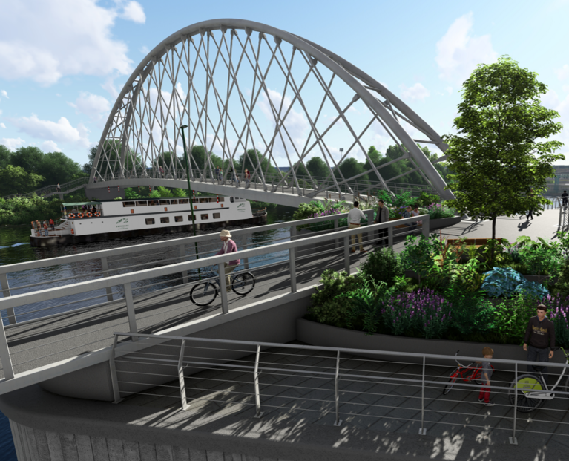
Why PH academia?
Freedom to define your work (if you can find funder, collaborators and supervisors)
Develop the evidence base in the areas where you think it is really needed for public health
Learn new techniques and methods
Work and collaborate locally, nationally or internationally
Be a “bridge” between public health research and public health policy/delivery

Slide 7


What do we actually research? East Mids examples
John, C., Guyatt, A. L., Shrine, N., Packer, R., Olafsdottir, T. A., Liu, J., ... & Tobin, M. D. (2022). Genetic associations and architecture of asthma-COPD overlap. Chest, 161(5), 1155-1166.
Taylor, M. J., Orton, E., Patel, T., Timblin, C., Clarke, R., Watson, M. C., ... & Kendrick, D. (2023). Effectiveness of systematically delivered evidence-based home safety promotion to improve child home safety practices: a controlled before-and-after study. Injury prevention, 29(3), 227-233.
Fletcher, R., Brough, G., Macmillan, D., Brock, L., Asgiersson, K., & Wilson, E. (2025). Exploring the informational needs and use of information by patients undergoing risk-reducing breast surgery: a qualitative study. International Journal of Health Promotion and Education, 63(1), 28-42.
Davies, N. P., Wilson, R., Winder, M. S., Tunster, S. J., McVicar, K., Thakrar, S., Willams, J. & Reid, A. (2024). ChatGPT sits the DFPH exam: large language model performance and potential to support public health learning. BMC Medical Education, 24(1), 57.

