Slide 1
Global Health Training Opportunities

Slide 2
Why Global Health Experiences are Valuable
More complete contextual understanding of UK public health challenges
Understanding of guidelines and legislation at international level and how they translate to UK
Perspective of other health systems and public health systems
Awareness of international level health structures, collaboration and partnerships
“Many of the public health challenges faced today are global health problems and require an understanding of the global dimensions of health and its influences.
Public health professionals need an understanding of the global influences on health to be able to improve the health of the population.”
Source: FPH Specialty Training Curriculum 2022
Notes:
Start by highlighting the value of GH placements, which enable trainees to gain a valuable global perspective on public health
The FPH curriculum emphasises that many of the public health challenges faced today are global health problems that require an understanding of the global dimensions of health and its influences
This is also reflected by the Specialty Training Gold Guide, which also supports these recommendations
& FPH have also endorsed a Global Health Placement Guide which highlights the value of GH placements
More specifically, GH experiences enable trainees to gain a:
More complete contextual understanding of UK and global PH challenges
Greater understanding of international and national legislation
Perspective of other health and PH systems
Awareness of international structures and partnerships
So, just to start by saying there is a lot of support for these types of opportunities, and a lot of value to be gained from them, but they are quite competitive and it can take a lot of work to make them happen.

Slide 3

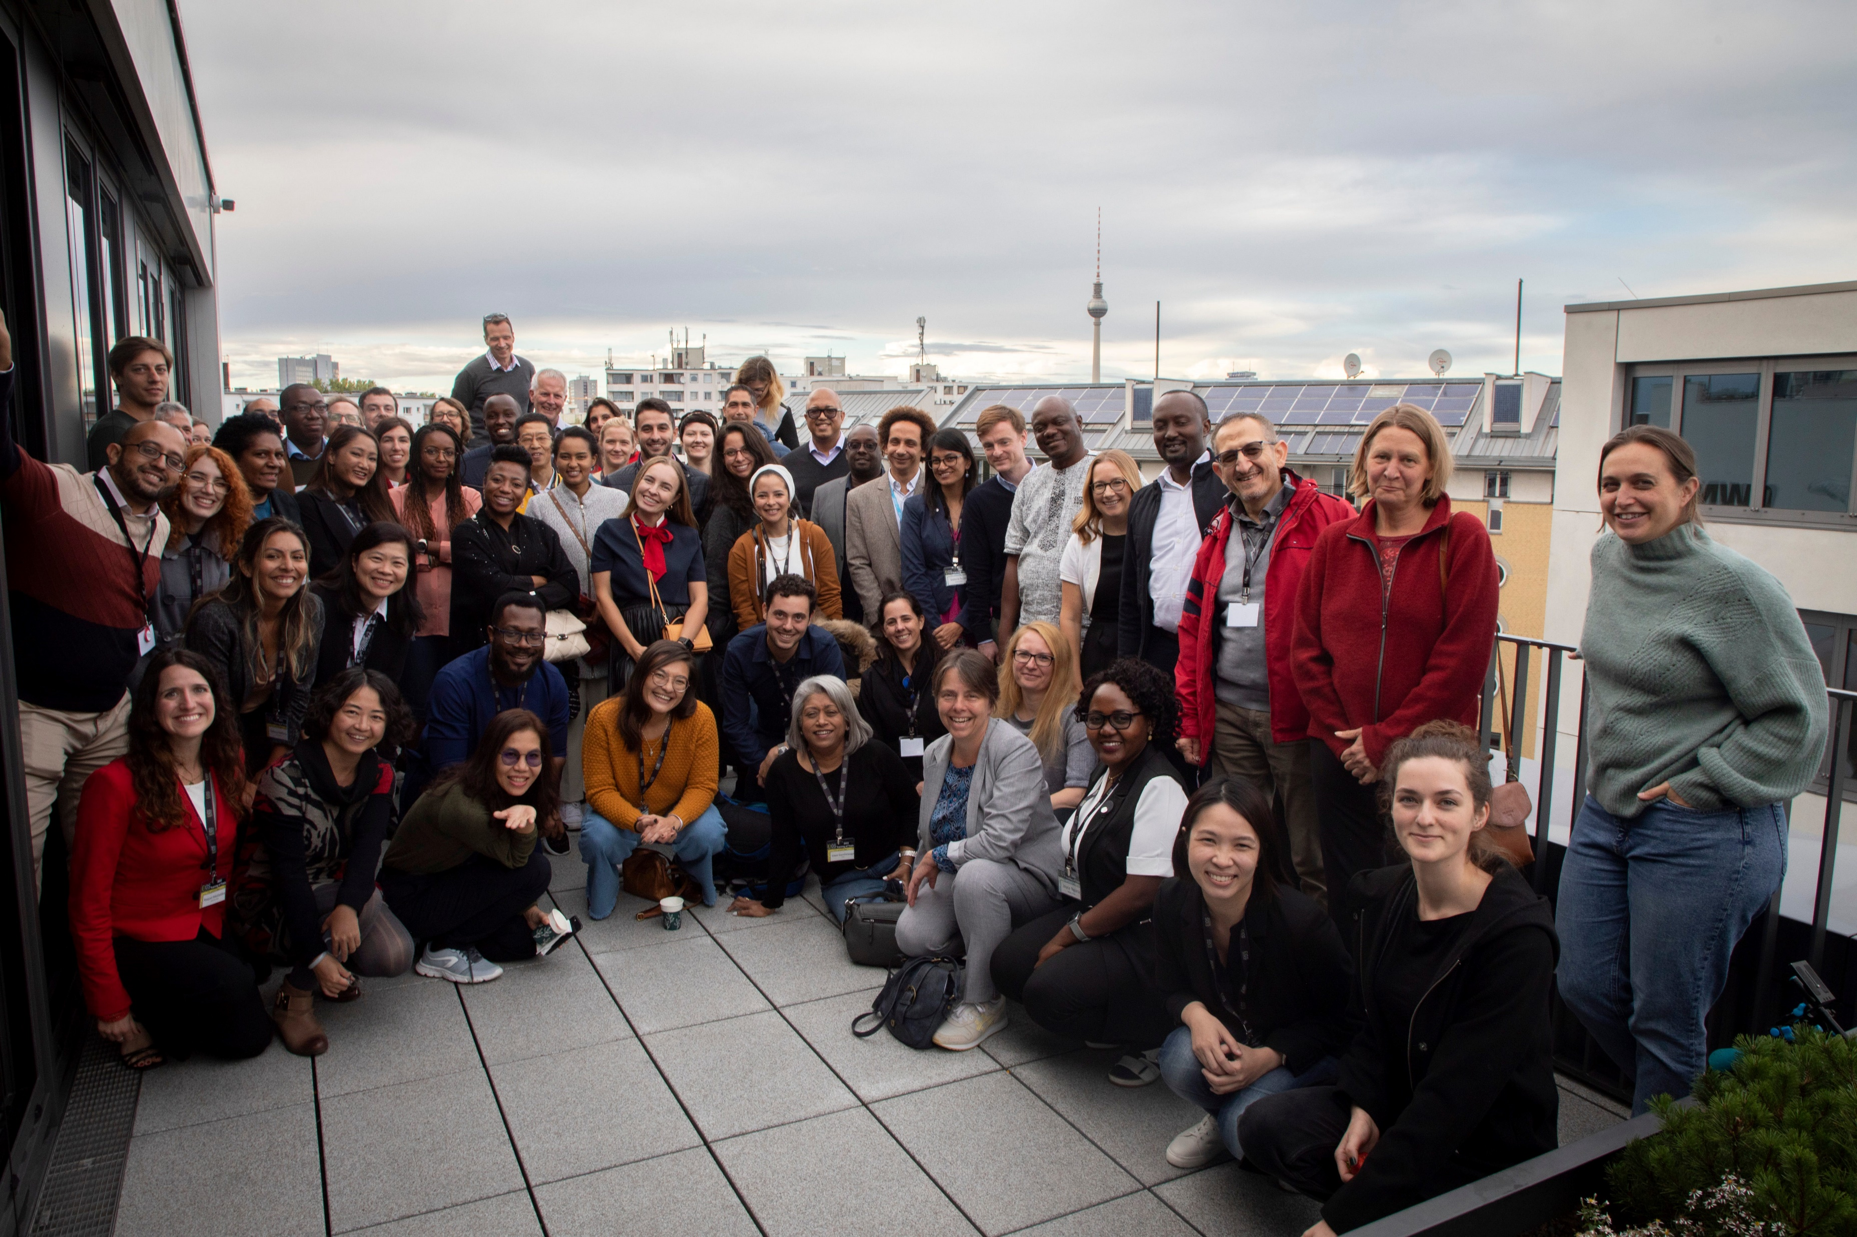
WHO Hub for Pandemic and Epidemic Intelligence
12-month OOPT placement
Counted towards my training time (supervised by FPH member)
Based in WHO Hub ‘Collaboratory’ Team (Laboratory for Collaborative Intelligence)
The WHO Hub is “working towards a world where collaborative surveillance empowers countries and communities to minimise the impact of pandemic and epidemic threats”
Notes:
During my training, I was able to complete two substantial GH placements
The first of which I‘m going to talk about was with the WHO Hub…
The WHO Hub was established by the Director-General of the WHO and the Chancellor of Germany in 2021 in response to the COVID-19 pandemic.
It’s an offshoot of the WHO Euro office, based in Berlin
12m… counted.. WHO Collaboratory

Slide 4
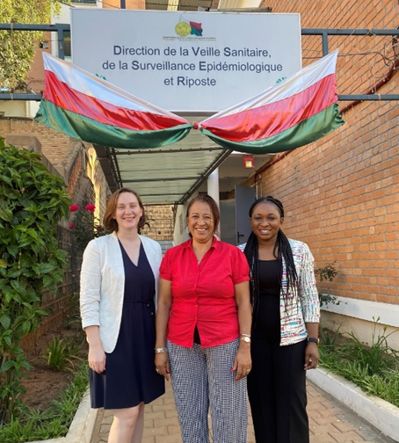
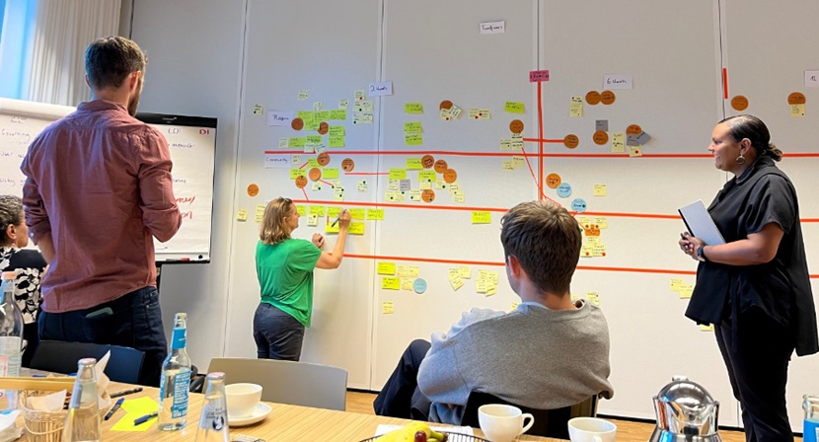
Key Projects:
Integrated Genomic Surveillance (IGS) Project
Global Repository of Epidemiological Parameters
Notes:
IGS
One of the major projects I was involved with was the IGS project, which aimed to build capacity to support the application of pathogen genomic data into existing PH systems in SSA…
Integrated genomic surveillance (IGS) is a public health strategy for monitoring infectious pathogens.
IGS involves combining data from different sources. Specifically, the results of DNA sequencing methods and genome sequence analysis for pathogen isolates from patient samples are merged with epidemiological information from the reporting system and further pathogen data. This aggregated data can then be quickly and systematically analysed.
This project worked to enable and establish IGS capacities within National Public Health Institutes in five countries across the African continent. I was particularly involved in a work package focused on policy analysis and capacity building in Madagascar.
Picture: meeting the head of the gov epi surveillance unit in Madagascar
Epi Parameters Project
Epidemiological parameters are used in mathematical models and are really important in understanding the transmission dynamics of pathogens and are used to help determine the potential impact of outbreaks in terms of morbidity, mortality, and geographical spread over time.
The epidemiological parameters project: involved a global collaborative working group coordinated by WHO to develop a global repository of epidemiological parameters - publicly accessible for modellers, epidemiologists, subject matter experts, and decision makers to inform mathematical models and public health response to epidemics and pandemics.
The idea is to enable faster and more transparent insight generation at the beginning and during an outbreak.
WHO collaboratory team day, planning the strategic objectives for the unit for the coming year

Slide 5
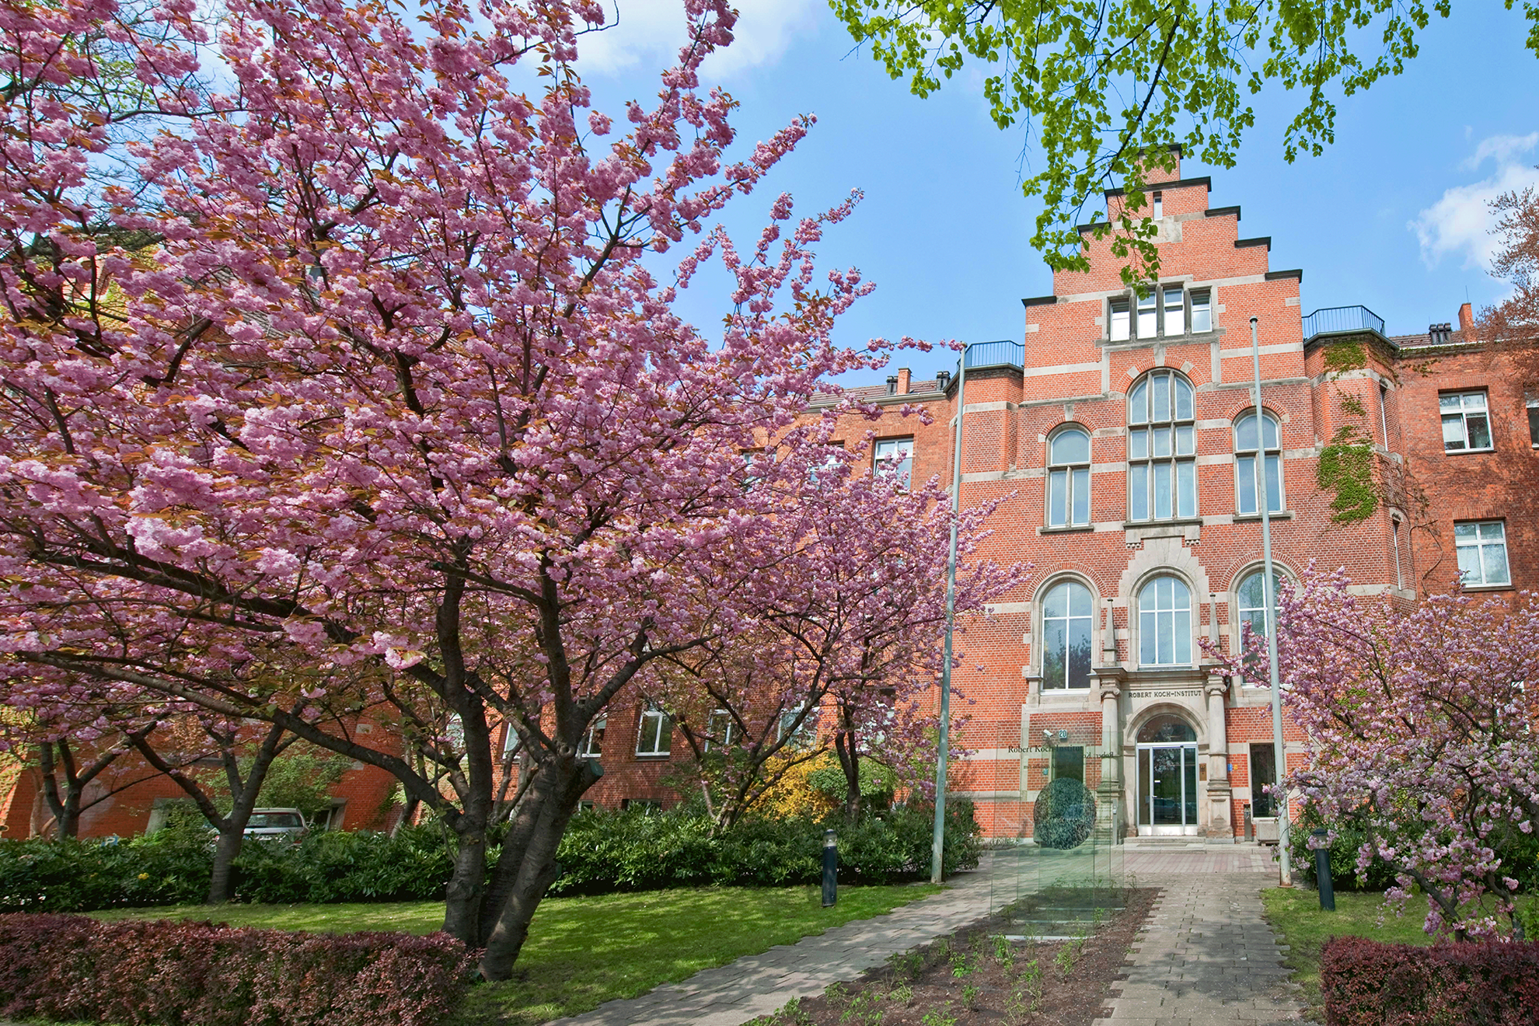
Robert Koch Institut (RKI): Centre for International Health Protection
18-month OOPE
Time out from training
“The RKI is a German federal government agency and research institute responsible for disease control and prevention. It is located in Berlin and as an upper federal agency, it is subordinate to the Federal Ministry of Health.”
Notes:
My other significant GH placement was with the RKI….
Centre for International Health Protection
RKI is a German… .national ph I….
This was an OOPE – time out of training

Slide 6
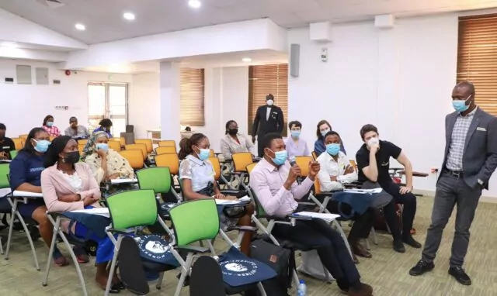
‘BCHW’ Project: Burden of COVID-19 Among Health Care Workers
Scientific researcher for one module of a mixed-methods, multisite, international research project investigating the burden of COVID-19 amongst healthcare workers in Germany and Nigeria.
The module evaluated the experiences of HCWs during COVID-19 to identify challenges, support needs, and effective coping strategies during health system shocks
Notes:
During this placement I was employed as….

Slide 7
What I Gained…
Strengthened academic and public health skills
International fieldwork and stakeholder engagement
(Field work in Nigeria and Madagascar; conference presentation in Colombia; scientific training in Seattle, USA)
Project and line management experience (harder to achieve within training)
Exposure to public health systems in Germany and SSA
KA9/10 competencies
Personal development and growth

Slide 8

Spectrum of Opportunities
To suit different stages of training, learning needs, and preferences
Shorter vs longer term placements
In vs out of programme
MPH
Academic opportunities
Sharing local work in a global context
Formal placements (OOPs, National Treasure Posts)
Notes:
I’ve spoken about my two most significant GH experiences, but I am really keen to emphasise that there is a spectrum of different GH opportunities available throughout training
- And that GH opportunities can be tailored to suit different….
Thinking about different opportunities that arise through training –
- In the earlier stages of training, there are opportunities through the MPH and dissertation projects, or with academic units across the region….
- There are also opportunities to share work completed locally in a global context, for example I contributed to a workshop in India about TB control using some work completed on increasing quality of TB care in prisons in the EM
- And of course there are more formal placements, including National Treasure placements or self-organised OOPs

Slide 9
Megan Evans
Megan.evans@ukhsa.gov.uk

