Slide 1
Health Protection
Dr Abina Dharmaratnam
Public Health Registrar ST3
Abina.dharamaratna@nhs.net

Slide 2
Overview
What is health protection?
UK Health Security Agency (UKHSA)
The health protection placement
On call out of hours
Opportunities

Slide 3
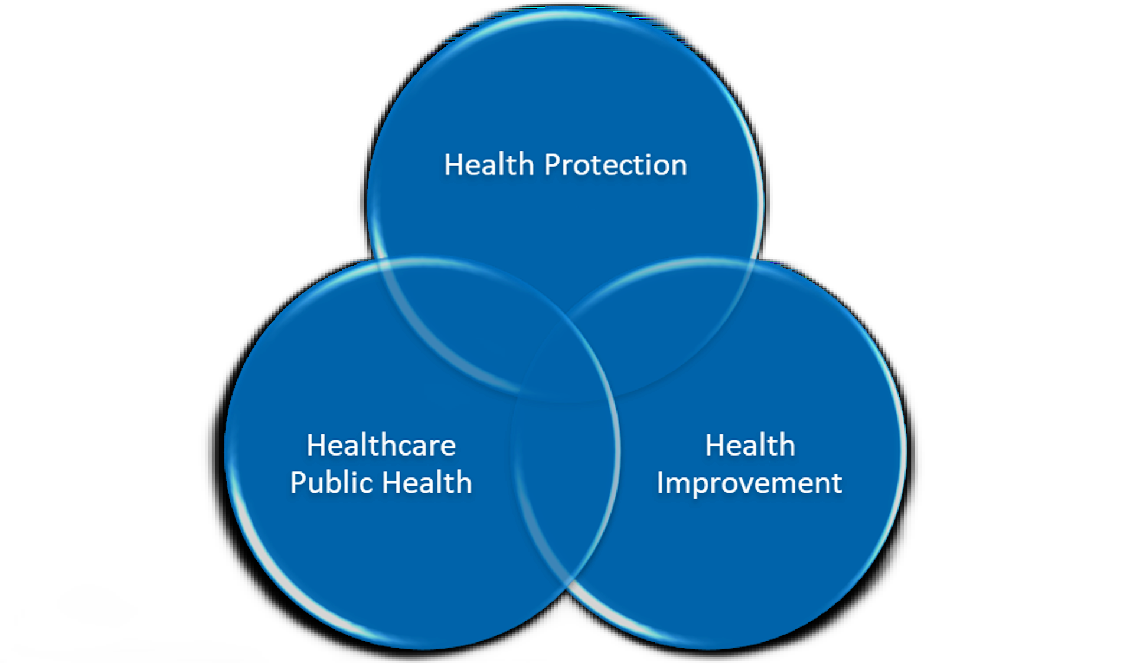
What is health protection?
Prevention, control and response to infectious disease, environmental hazards, chemical & radiological threats
Surveillance
Outbreak/incident investigation and management
Risk assessment
Control measures
Emergency preparedness, resilience and response
Longer term strategic work with regional partners and national networks

Slide 4

UK Health Security Agency - UKHSA
Government agency responsible for health security
Safeguards against infectious diseases, chemical &radiation hazards, emerging threats and environmental hazards
National specialist capability + regional Health Protection Teams (HPTs)
Multi‑agency working - NHS, local authorities, microbiology labs, emergency services, Local Resilience Forums (LRF)
National Specialist Teams
Radiation, Chemicals & Environmental Hazards (RCE)
Emergency planning & resilience (EPPR)
Field services
Disease‑specific units (TB)
Border Health

Slide 5
The health protection placement
4 months
Usually after passing Diplomate exam
East Midlands regional health protection team – Seaton House, Nottingham
Acute response centre (ARC) – handle enquiries, information gathering, risk assessment, contact tracing, rapid advice, incident management, coordinate control measures, documentation of case notes
Outbreak report – outbreak control meetings
Project

Slide 6
On call/Out of hours
Shadowing and in hours ARC before independent shifts OOH
Typical calls: urgent lab results, information gathering, risk assessment, contact tracing, chemoprophylaxis
Discussion and advice from CCDC (Consultant in Communicable Disease and Control)
Balancing precaution with practicality out of hours

Slide 7
Opportunities
Health Protection Rep x2 – Public Health Speciality Registrar Committee
Organising learning and development days
Field epidemiology training programme (OOP)
National treasure placements
MPH dissertation projects
Conferences

Slide 8

Questions?
Abina.dharamaratna@nhs.net

