Slide 1
A Career in Healthcare Public Health
Improving Population Health Outcomes Through Services
Presented by:
Mandy Clarkson
Consultant in Healthcare Public Health
Notes:
Standard title slide

Slide 2
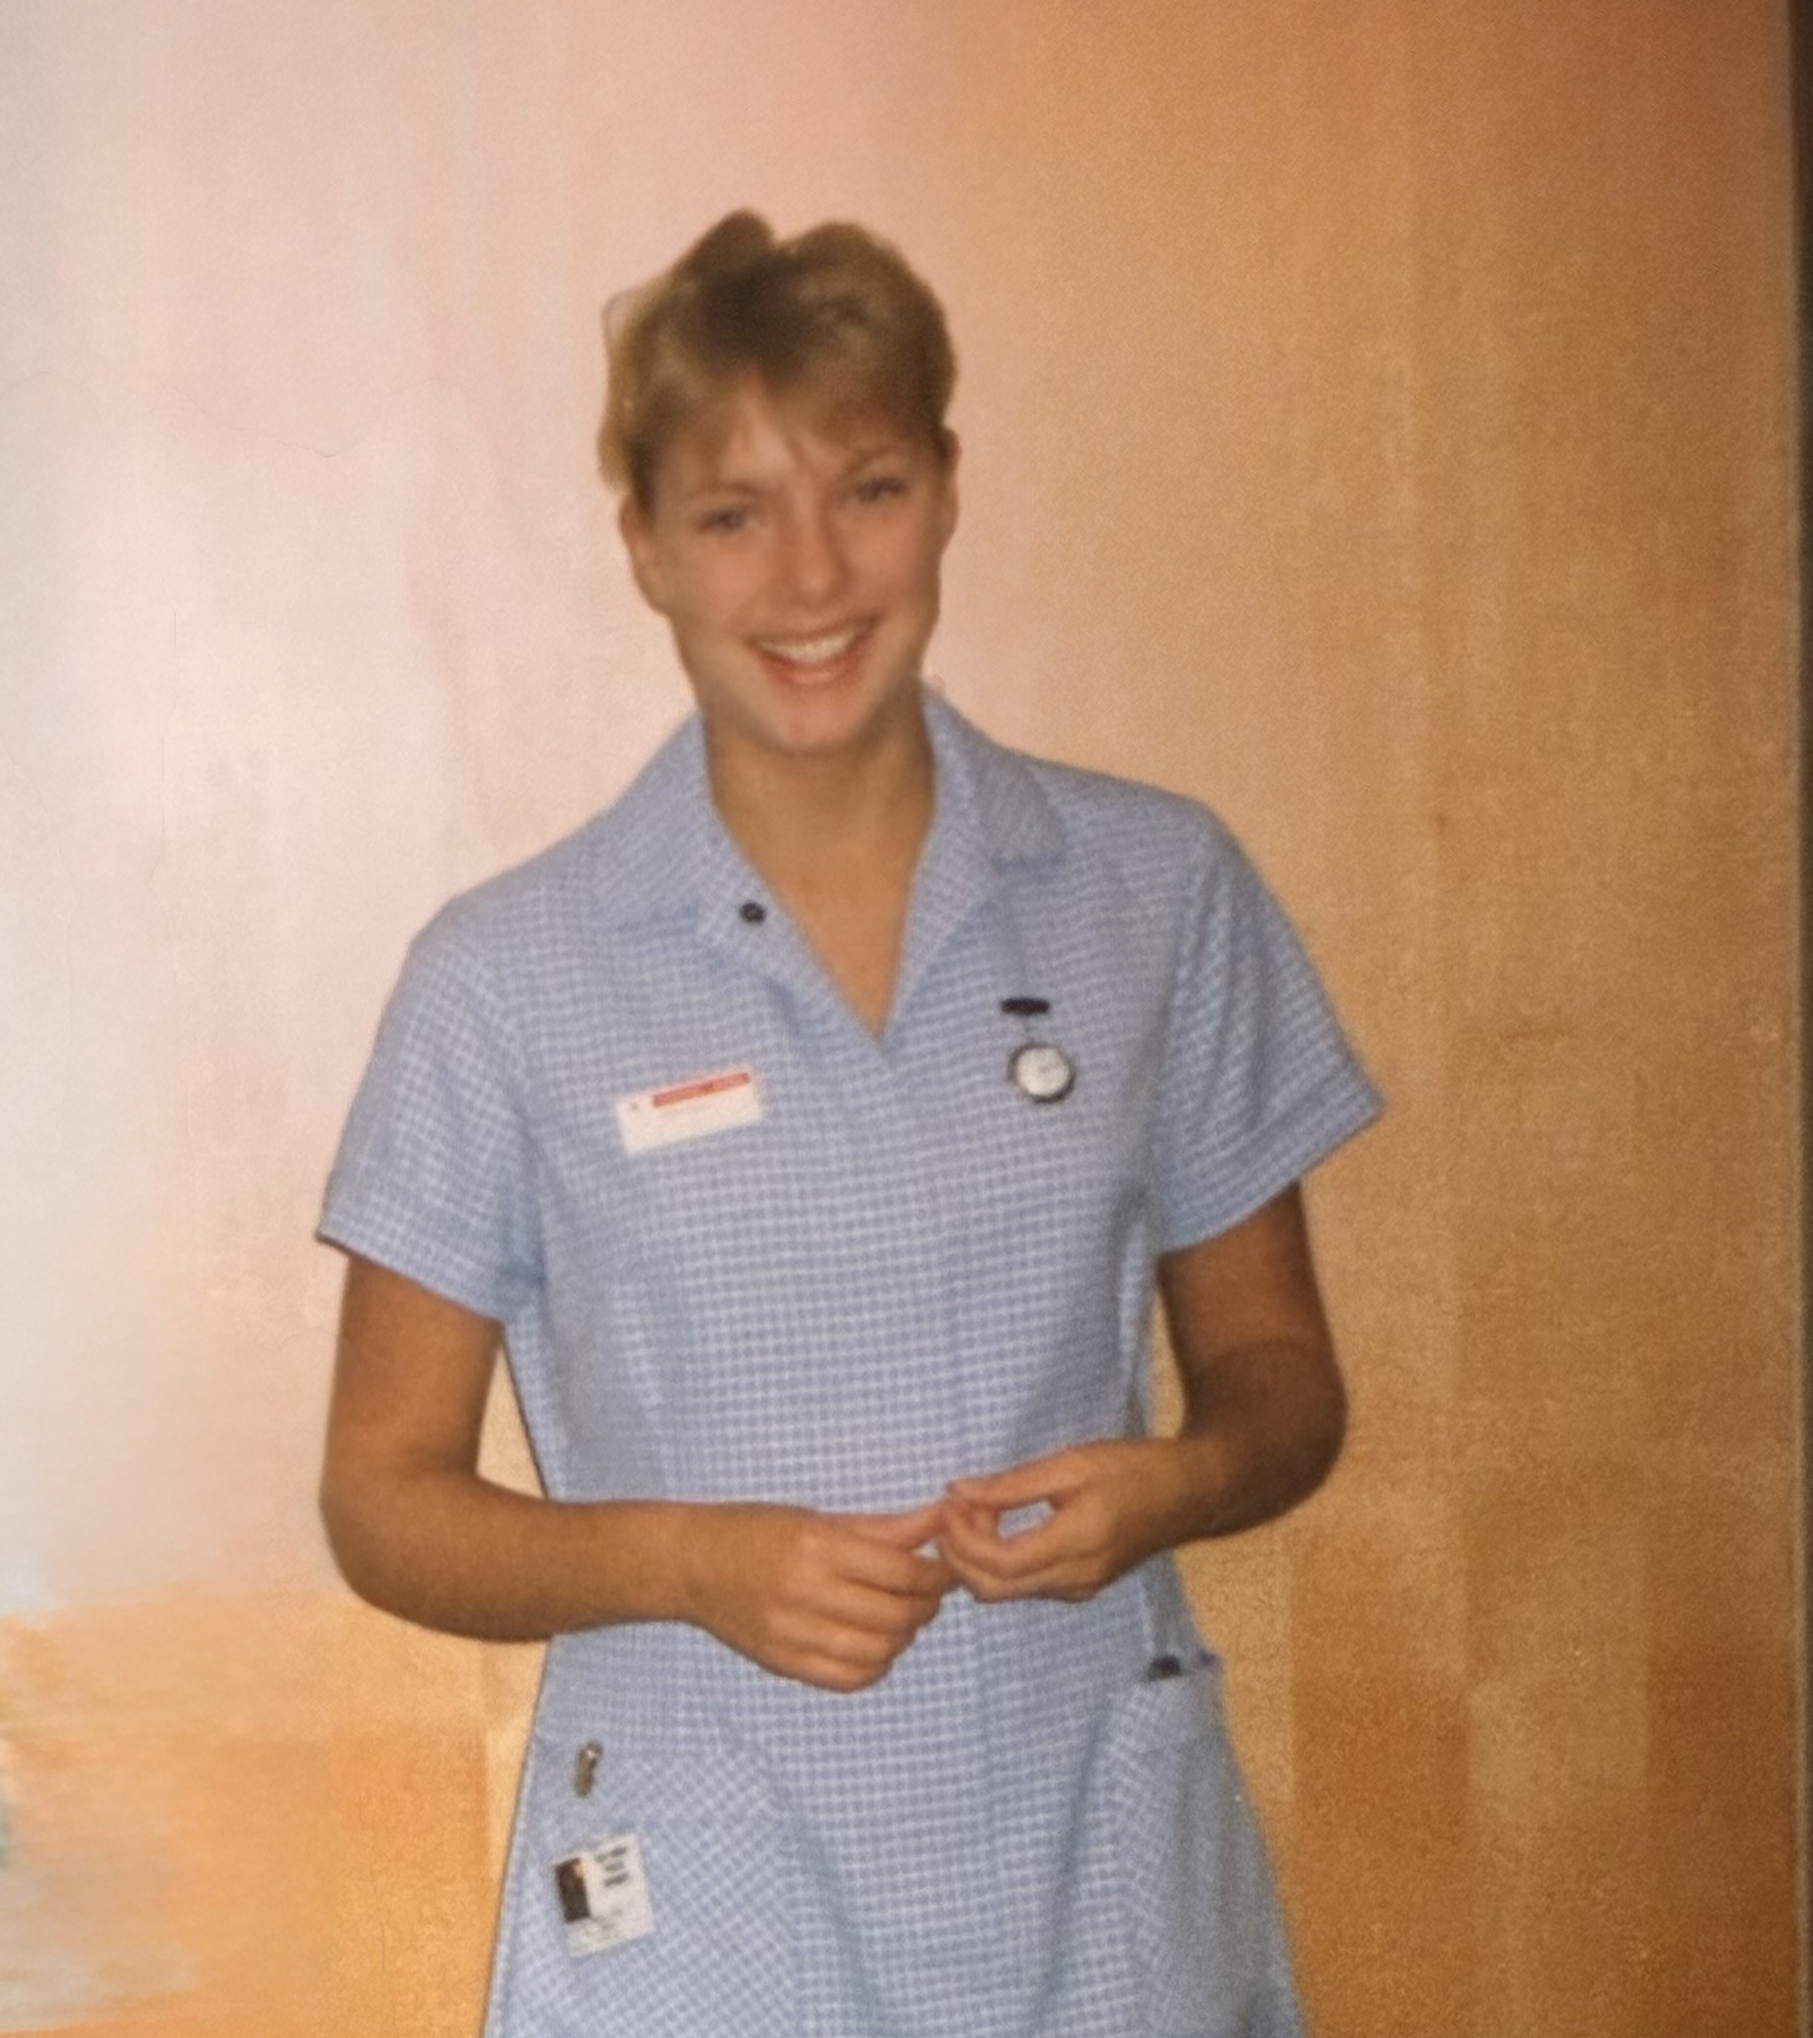
Welcome & Introduction
Notes:
A quick personal introduction
Purpose of the session is to give you a sense of HCPH and our training location in the East Midlands, and also the possible routes into it…
My journey:
Nurse background
Varied clinical roles: community nursing sparked my interest in the influence of how we live on our health.
Opportunity to do MPH; led to health protection role.
Realised how much more there is to public health…
Loved the clinical work best!

Slide 3
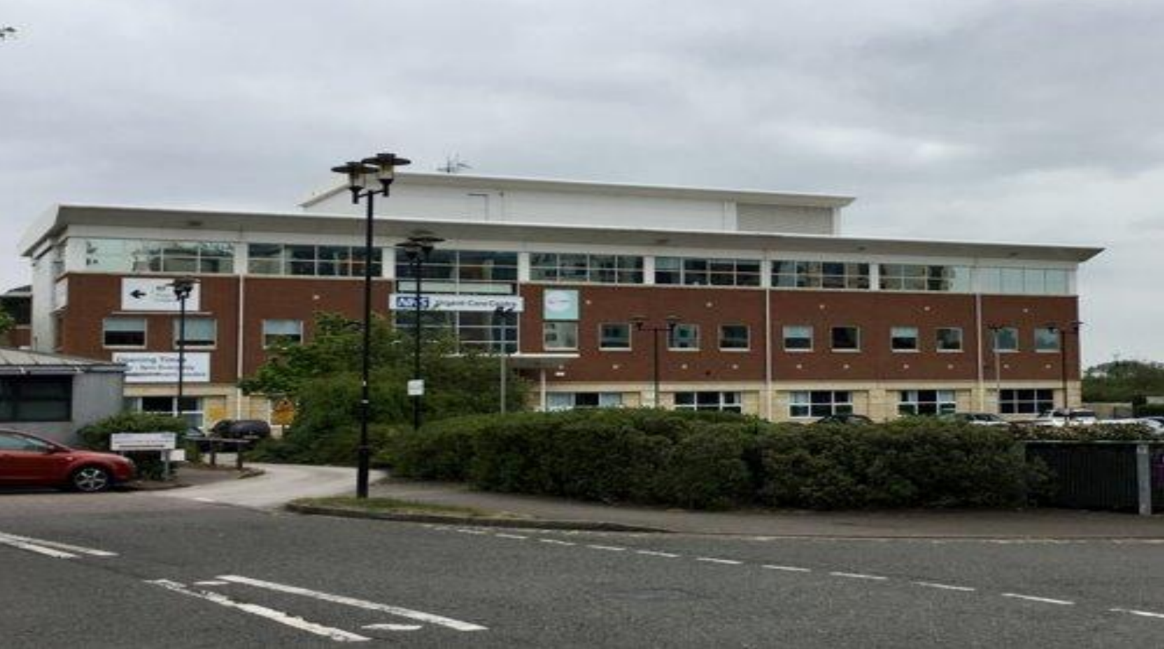
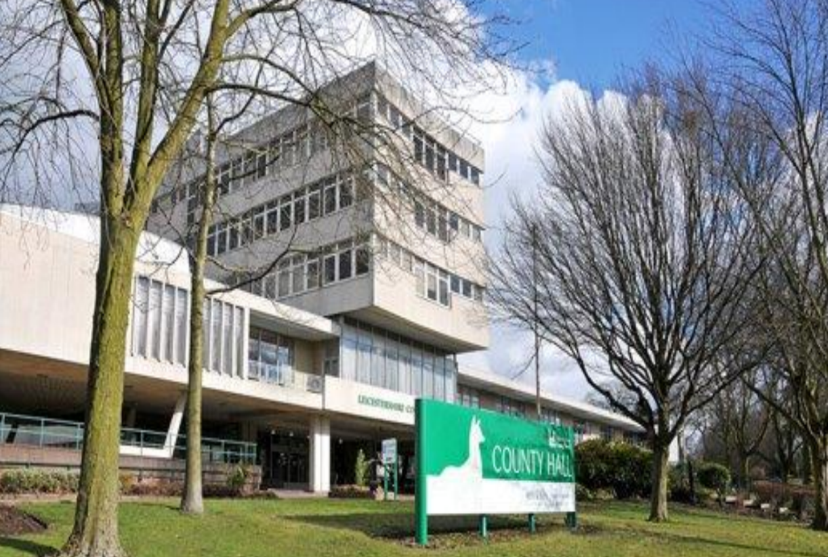
Public Health Directorate, NHS England – Midlands
Organisation | NHS England (NHSE), Midlands
Base Address | Registrars are based at Seaton House, in the centre of Nottingham. UKHSA and OHID staff also based at Seaton House. The team serve the whole of the Midlands and staff are based in Nottingham, Leicester and Birmingham. There is very close working between the three organisations and our registrars work on projects for each organisation.
About the Team | We are a team of consultants, public health programme teams and business support members. Our consultants often sub-specialise and are experts in their field of practice. There is a public health training lead in each of the three organisations.
Website | www.england.nhs.uk

Slide 4
What is Healthcare Public Health (HCPH)?
Health Protection
Healthcare Public Health
Health Improvement
One of the three pillars of public health:
Definition: The branch of public health focused on maximising the health gain from healthcare services
Aim: Ensure health services are effective, equitable, efficient, and meet population needs

Slide 5
How HCPH Differs from Other Public Health Domains
The emphasis is on determining population need, ensuring evidence-informed commissioning, reducing healthcare inequalities and achieving health equity
Health Protection: Focus on communicable disease control, environmental hazards
Health Improvement: Focus on lifestyle, social determinants, prevention
HCPH: Focus on healthcare systems, service planning, clinical effectiveness, and equity

Slide 6
HCPH function overview
Dental team
Specialised team
Strategic team
H and J team
HI team
Commissioning support
East and West PH Alliances
Advice and leadership to NHSE across programmes and clinical areas
Support NHS improvement and assurance
Advice to commissioning teams
Bridge across whole system
Advice and policy work alongside OHID colleagues
National advice and policy
Support systems to implement CORE20+5 (all age and CYP)
Enhance action on Heath Inequalities
Support whole system to improve equity using tools for tangible actions
Oral health advice
Epidemiology
Fluoridation
Advise commissioning teams
Support designated networks
Advice and policy work within national programmes of care
National IFR rota
Health inequalities, quality improvement, evidence informed decision making, response, bridging and linking, professional activity and training
Knowledge intelligence and mobilisation, business support, workforce planning, strategy and planning
Notes:
Our five 'pillars' of subspecialties

Slide 7
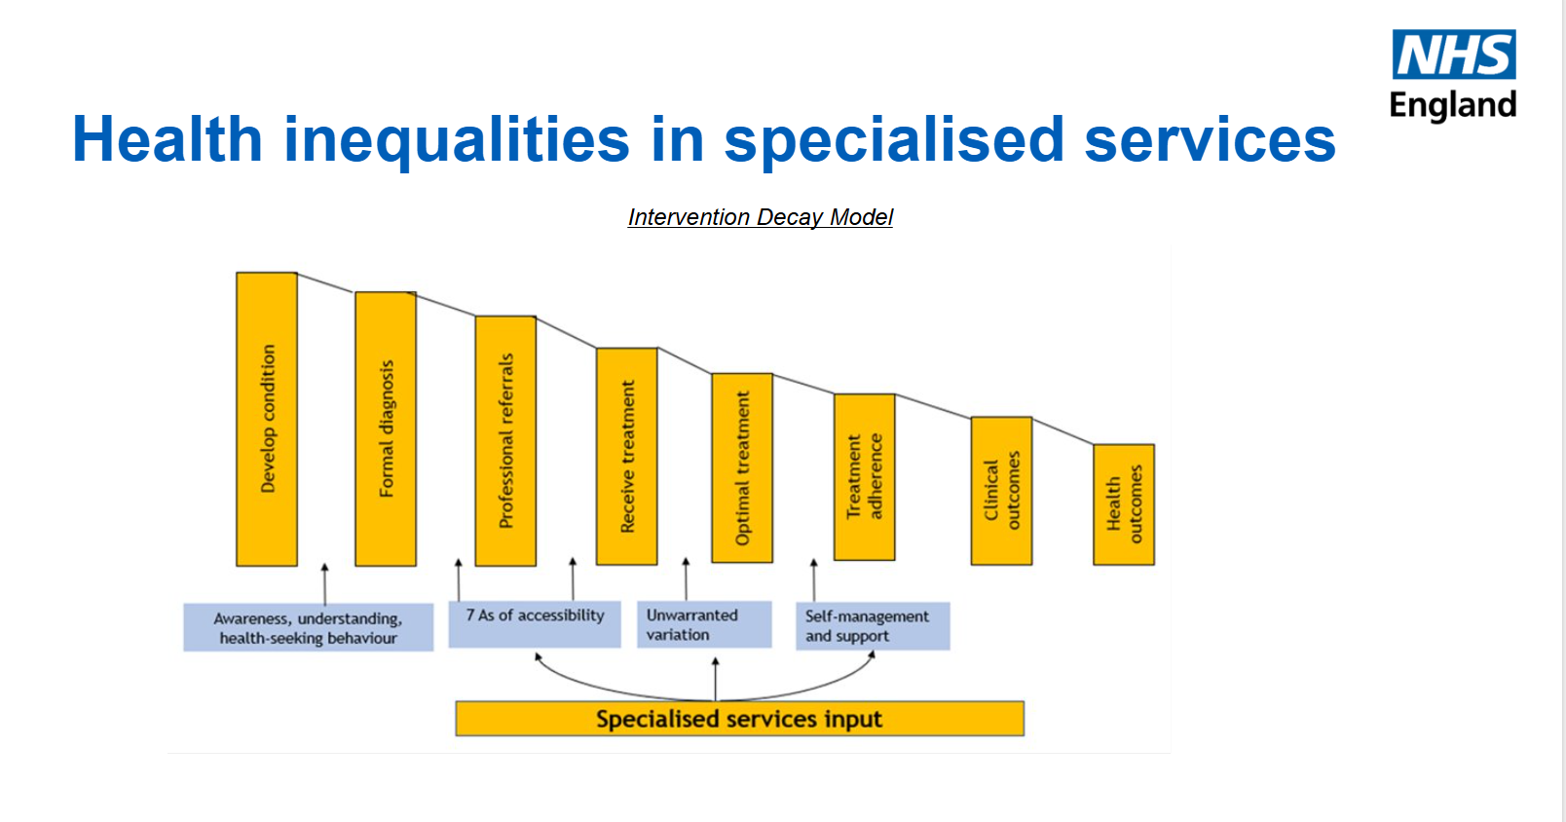

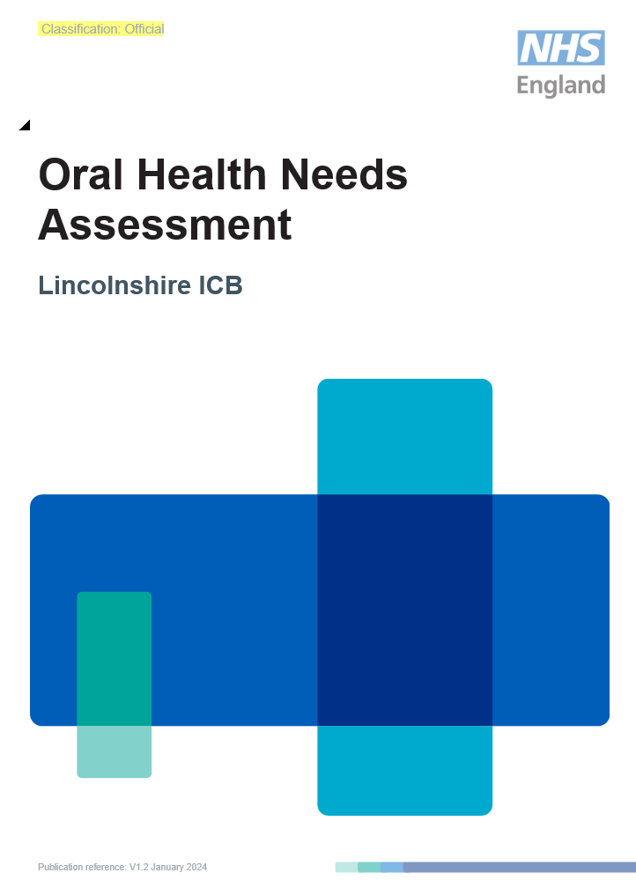
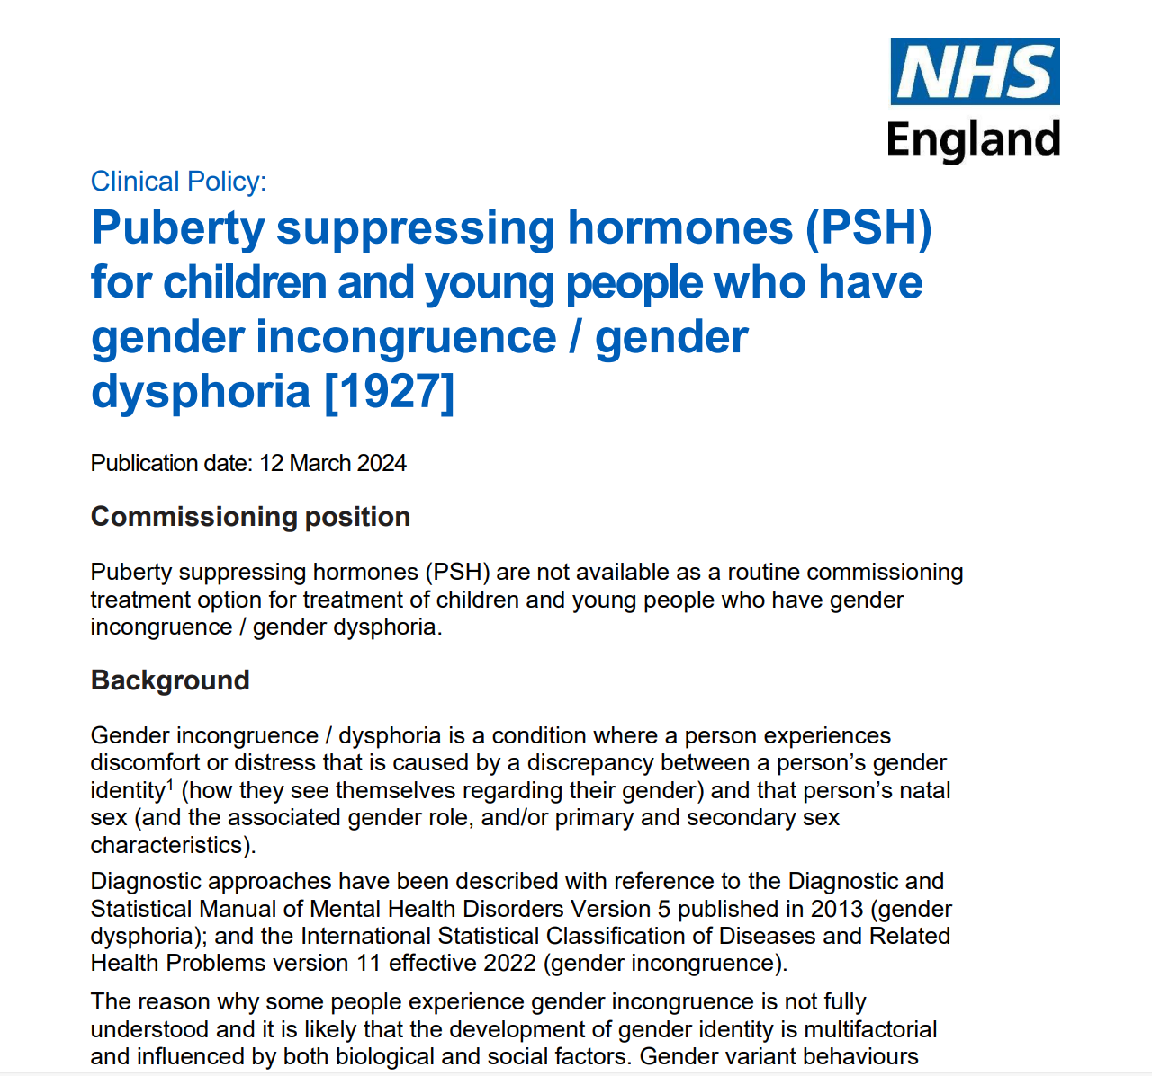
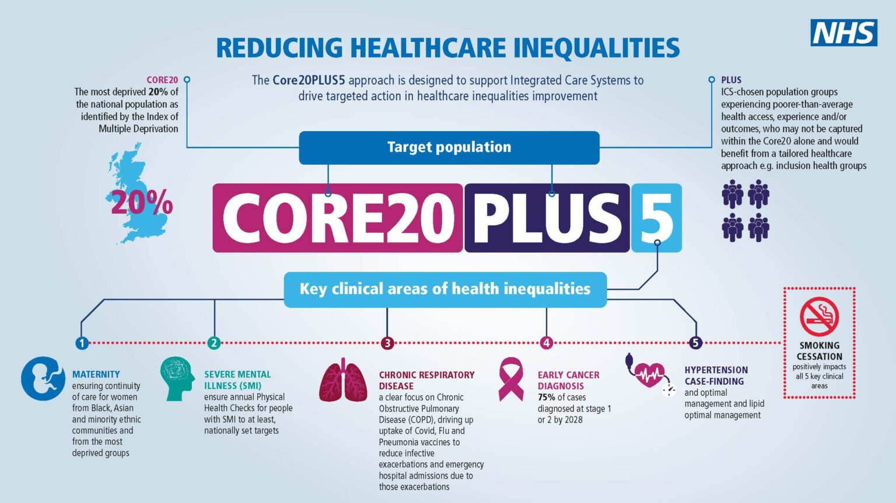
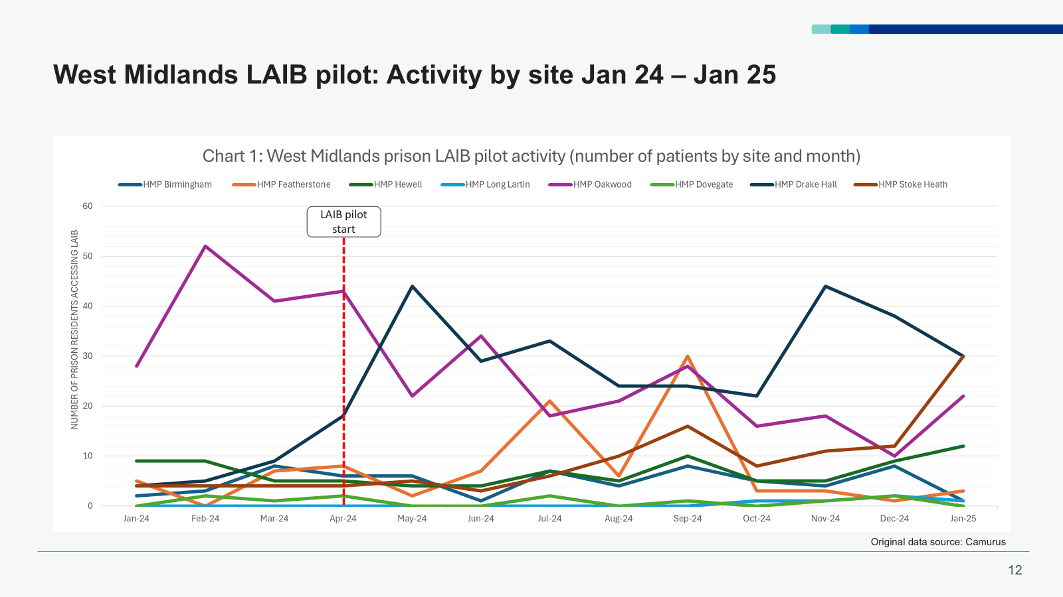
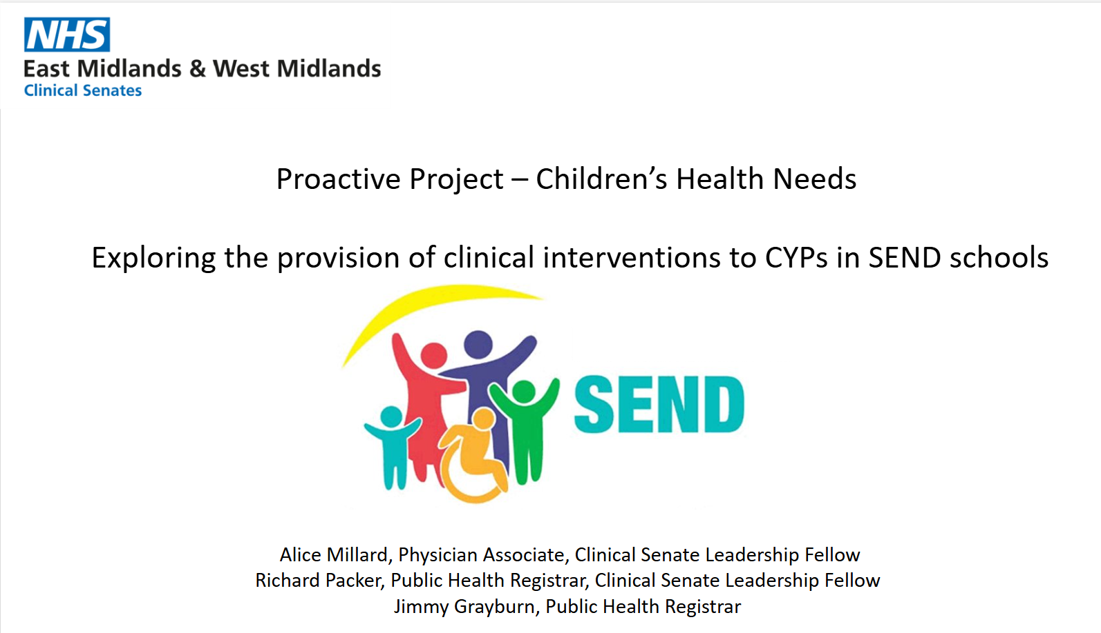
What Do We Actually Do?
Needs assessments
Service review
Clinical effectiveness and prioritisation
Evaluate interventions
Map whole pathways
Health equity audits
Model demand & capacity
Inform commissioning decisions, using a public health perspective

Slide 8
Treatable and preventable mortality, age standardised death rates per 100,000 population by CCG, 2020 :
Age-standardised death rate for treatable and preventable deaths per 100,000 population by CCG in the Midlands (2020).
Notes:
We do like to look at a lot of data!
We are most interested in how we can improve health through services, BUT we also help others understand why these differences occur…
https://www.ons.gov.uk/peoplepopulationandcommunity/healthandsocialcare/causesofdeath/datasets/avoidablemortalitybyclinicalcommissioninggroupsinenglandandhealthboardsinwales

Slide 9
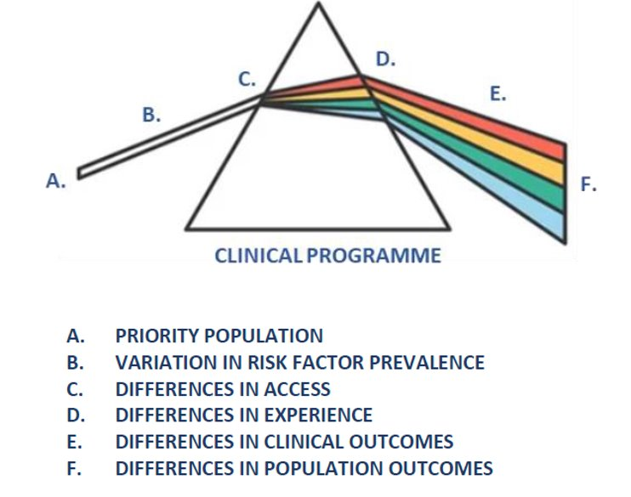
Inequity in healthcare
The influence of unfair socioeconomic conditions can be exacerbated by the design and delivery of services.
Ways to improve equity:
Tackle variation
Make services inclusive
Data-driven advocacy
Source: Chris Bentley, Julia Knight et al

Slide 10

How deep is the mud?
…depends who you ask!

Slide 11

What kind of gear do you need?
…to get the most benefit

Slide 12
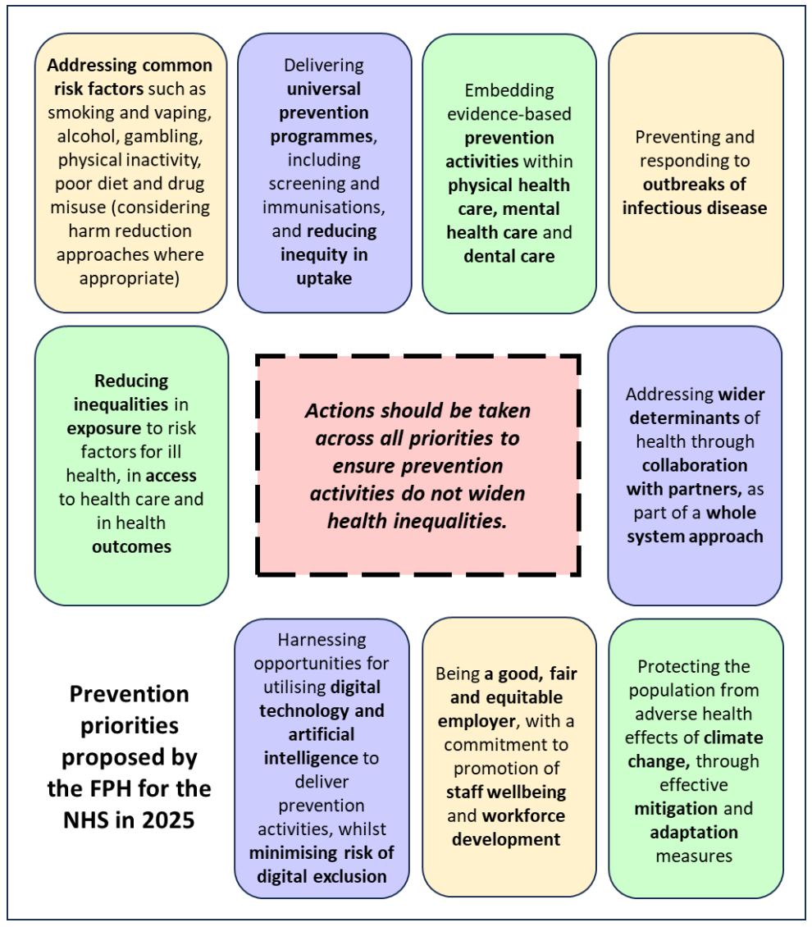
Prevention
The 10-Year Health Plan promises a shift from sickness to prevention. Covering risk factors – smoking, poor diet, alcohol misuse and lack of exercise.
It is, however, a plan for the NHS. Its focus is on mitigating the consequences of sickness rather than tackling the underlying drivers that cause ill health.
The Faculty of Public Health recommends the prevention priorities opposite for the NHS.

Slide 13

Specialised services support people with rare and complex conditions
New treatments include gene therapy for blood cancers and sickle cell disease and immunotherapy drugs which use the immune system to attack cancer cells.
NHS England sets the funding policy by prioritising which therapies will benefit the most people.
When a patient does not fit the policy or there is no policy because the condition is too rare, clinicians can ask NHS England to fund a treatment for that patient alone.
Notes:
CAR-T – chimeric antigen receptor T-cell – therapy
The interim service specifications for CAR-T therapy can be found at the following links:
Axicabtagene ciloleucel chimeric antigen receptor T-cell (CAR-T) therapy for the treatment of adult patients with relapsed or refractory large B-cell lymphoma
Tisagenlecleucel chimeric antigen receptor T-cell (CAR-T) therapy for ALL and diffuse large B-cell lymphoma (DLBCL)
Can you explain what the treatment involves?
The treatment involves several steps over a number of weeks.
First the patient’s blood is taken and is sent off to the manufacturer’s laboratory. Here the patient’s blood is ‘trained’ to fight the cancer cells.
The CAR-T blood is then transported back to the hospital and the patient is administered with the CAR-T to treat their condition.
Currently, NICE has approved CAR-T use in the NHS for the following indications.
Relapsed or refractory B-Cell acute lymphoblastic leukaemia (ALL) in people up to the age of 25 years
Relapsed or refractory diffuse large B-cell lymphoma (DLBCL), primary mediastinal large B-cell lymphoma after 2 or more systemic therapies
Relapsed or refractory diffuse large B-cell lymphoma after first-line chemoimmunotherapy
Relapsed or refractory B-cell acute lymphoblastic leukaemia in people aged 26 years and over
Relapsed or refractory mantle cell lymphoma
Relapsed or refractory aggressive B-cell non-Hodgkin lymphoma

Slide 14
Skills You’ll Develop
Epidemiology and data interpretation
Strategic thinking and systems leadership
Communication and influencing
Policy analysis and service design
Collaborative working
Critical appraisal of clinical evidence
Recent projects by our registrars include:
A review of the evidence of effectiveness for robotic surgery, with the East/West Midlands Clinical Senates.
A needs assessment for children and young people with eating disorders
Review of health inequalities in respiratory disease in the Midlands
Range of projects relating to neonatal mortality and infant mortality
Review of data and evidence relating to avoidable mortality
Part of the team investigating a screening incident
Registrars have had a number of these published in peer-reviewed journals.

Slide 15
Where you might come from or where you might get to…
Career Progression in Healthcare Public Health
Entry Points:
Public Health Specialty Training (medical and non-medical routes)
Fellowships (e.g. FPH, Darzi)
Academic/Public Health MSc or PhD
Early Career Roles:
Public Health Practitioner
Specialty Registrar
Analyst or Project Manager in ICBs or NHS England
Mid-Career Roles:
Consultant in Healthcare Public Health
Senior Public Health Manager
Academic/Public Health Researcher
Senior Leadership:
Deputy Director of Healthcare Public Health
Regional/National Public Health Lead
Chief Medical Officer/Public Health Advisor roles
Cross-sector Opportunities:
Policy roles in DHSC, NICE, NHS England
International health organisations (WHO, global NGOs)

Slide 16
End slide

