Slide 1
Some time in the life of a local authority
Consultant in Public Health
Mary Hall, Leicester City Council
Mary.hall@leicester.gov.uk

Slide 2
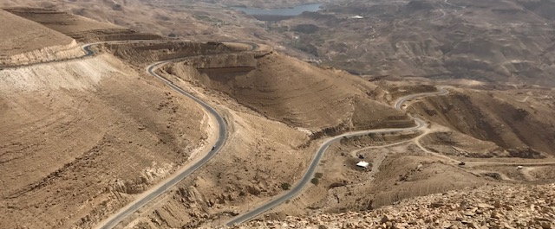
All roads lead to public health
Training programme
Nurse
Travel
Voluntary sector
Aid worker
University

Slide 3
And now?
Drugs and alcohol
Health protection
  Screening and immunisation
  Disease outbreak
  Community infection prevention and control
  TB
Educational supervisor
National eligibility check

Slide 4

A sort of typical week
Tuesday morning: 150 + emails [**Boo!**] But some
Naloxone training
Botulism
TB comms
Vaccination community engagement project
Bed bugs IMT
Drugs and alcohol strategy
Continence research project

Slide 5

Naloxone training

Slide 6


Drug and alcohol strategy

Slide 7
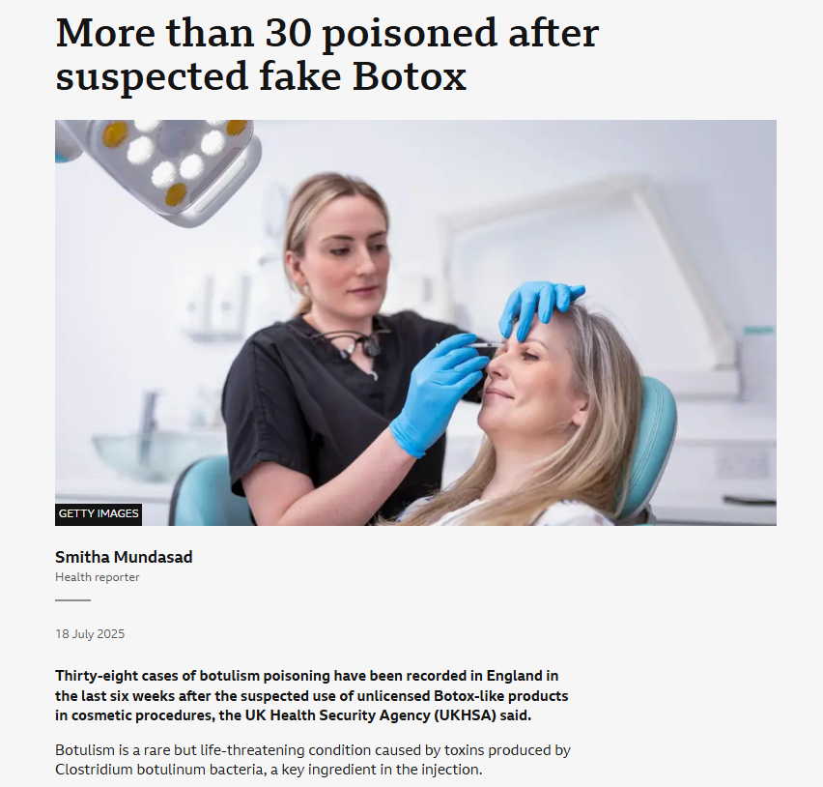
Botulism

Slide 8
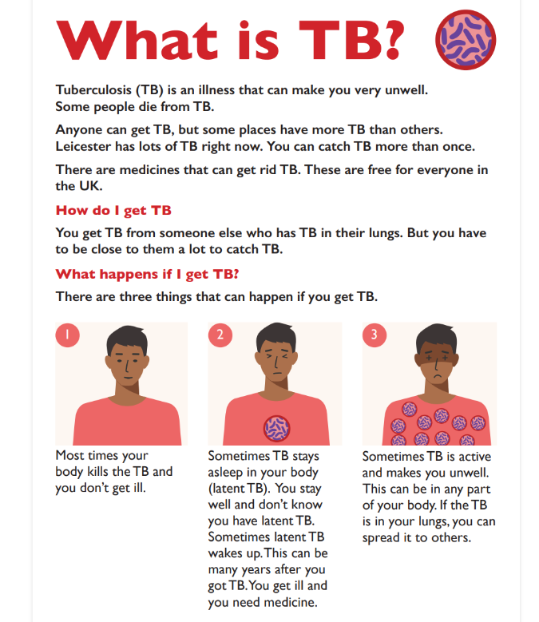
TB comms

Slide 9
Continence research project
What is the best way to manage urinary incontinence in care home residents?
What is currently happening?
Does it cause any problems?
What can we do about it?
  How do we get other people interested?
How?
And how do we make this sustainable?

Slide 10
And all the bits and bobs
“Are you interested in being involved in….”
  Work on frailty and falls (yes!)
  Individual funding requests (yes!)
  Paediatric antimicrobial resistance (yes!)
“I need a report/presentation for…”
  PH taster day
  Scrutiny
  Health and wellbeing board
“Can you give some feedback on…”
  The vaccination strategy
  GP development plans
  TB comms material
  The job description that needs to be developed.

Slide 11

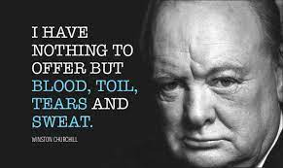
And finally..
LONG LIVE THE MOUNTAINS WE MOVE, I HAVE THE TIME OF MY LIFE FIGHTING DRAGONS WITH YOU

