Slide 1
Public Health Training in The East Midlands

Slide 2
Contents
Introduction (hyperlink all please)
Our Region
Our Specialty School
Training Programme
Specialty Training
Masters Degree in Public Health
Training Placements
Local Authorities
NHS Trusts
Government Agencies
Academic Placements
National Placements

Slide 3
Introduction

Slide 4
Our Region
The East Midlands is the 4th largest region in England stretching from the Lincolnshire Coast to the very centre of the country. It is made up of the counties of Derbyshire, Leicestershire, Lincolnshire, Northamptonshire, Nottinghamshire, and Rutland and has a population of some 4.9 million.
The geography of the region is diverse from the flat coastal plain of Lincolnshire, the river valley of the Trent which contains the large cities, rolling countryside (88% of the area of the region is characterised as rural) and the beautiful peak district.
10% of our region is designated an “Area of Outstanding Natural Beauty”
66% of our population live in urban areas, including bustling cities and market towns. 18% of the population live in the most deprived quintile nationally.
Much of the East Midlands has good transport links with travel times to London and Manchester with average travel times of less than 2 hours.

Slide 5
Our specialty school
Welcome to the East Midlands School of Public Health. We are a friendly, supportive, and innovative specialty school delivering excellent quality training for registrars wishing to become consultants in Public Health.
Our programme aims to provide the knowledge, skills and experience required to be an effective public health specialist. The programme covers the academic, health protection and service components of public health practice.
Training follows the Faculty of Public Health curriculum https://www.fph.org.uk/training-careers/specialty-training/curriculum/
Training may be undertaken on a full or part time basis.
We welcome applications to the programme from medical doctors and those from a professional background other than medicine. Further information on how to apply to the training programme can be found on the Faculty of Public Health website and via HEE Specialty Recruitment Portal.
We provide training opportunities across the six counties that make up our region in a range of settings including Local Authorities, NHS Trusts, Universities, UK Health Security Agency (UKHSA), Office for Health disparities (OHID), NHS England we also support our registrars wishing to undertake placements with national and international bodies.

Slide 6
Our Team
The school is led by a senior faculty team which includes;
Head of School - Julie O’Boyle
Training Programme Director (North) – Andy Fox
Training Programme Director (South) - Helene Denness
We are each consultants in Public Health working within region
We are supported by
Account Manager – Nicky Crane
Faculty Support Administrator - Sangeeta Chavda
We are responsible to the Postgraduate Dean through our Specialty Training Programme Board.

Slide 7
Training Networks
We divide our region into 6 training networks
Leicestershire and Rutland
Northamptonshire
Nottinghamshire
Derbyshire
Lincolnshire
UNO (UKHSA, OHID, NHSE)
Each network has a training network co-Ordinator (TNC) who is an education supervisor and works closely with the faculty management team. TNC’s are members of the School board

Slide 8
1 | Nottingham City Council The University of Nottingham Nottinghamshire Healthcare Trust
2 | Nottinghamshire County Council Local Office UKHSA & OHID
3 | Derby City Council
4 | Derbyshire County Council Derbyshire Community Health Services
5 | Leicester City Council Leicestershire County Council (Provides Public Health services to Rutland County Council) University of Leicester NHSE WTE offices Local offices NHSE
6 | Lincolnshire County Council
7 | West Northamptonshire County Council North Northamptonshire County Council
8 | University of Sheffield

Slide 9
Specialty Registrar Training Committee
We have an active SpR training committee who organise monthly learning and development days.
SpR’s (through the various committee roles) sit on the School Board and it’s committees
SpR’s are actively involved in the commissioning of education programmes for the specialty and the business planning for specialty training

Slide 10
Training programme

Slide 11
Public Health Training
The Public Health Specialty Training Programme is a 5-year programme, at the end of which successful graduates are eligible to join the Public Health Specialist Register with either the GMC or the UKPHR and apply for Public Health Consultant posts.
Training follows the Faculty of Public Health curriculum (available here)
Training is divided into two phases, Phase 1 which focuses on gaining knowledge of public health and Phase 2 which focuses on applying that knowledge in practice.
Training may be completed on a full or part-time basis.
Registrars are expected to undertake training in at least two different approved training locations within the region and in addition are required to undertake a minimum of 3 months placement in health protection

Slide 12
The Training Programme
Training is divided into 2 phases. Phase 1 usually lasts 2-3 years and includes completing a master’s degree in public health during the first year. For those individuals joining the training programme with a master’s degree in public health entry at ST2 level is available. Phase 2 of training lasts 2 years and focuses on applying knowledge to public health practice.
Knows

Slide 13
Masters Degree in Public health
Registrars joining the training scheme who do not have a masters degree in public health will undertake a masters degree at either the University of Nottingham or the University of Sheffield
Details of the programmes offered by each university can be found below
Master of Public Health MPH/PGDip/PGCert 2025 entry - University of Nottingham
Public Health MPH PG Certificate PG Diploma | 2025 | Postgraduate (sheffield.ac.uk)

Slide 14
Local Authority placements

Slide 15
Derby City Council
Name of organisation | Derby City Council
Training Network | Derbyshire Training Network
Base Address | The Council House, Corporation Street, Derby DE1 2FS
Working arrangements | We have a flexible working policy, which includes working from home. Team members (including registrars) are expected to come into the office when a face- to-face meeting suits the progression of an area of work and for our monthly department meetings.
Description of placement | Derby is an ethnically diverse city with high levels of deprivation and health need. Life expectancy and healthy life expectancy are below the England average. The gap in life expectancy between the most and least deprived communities at 10 years, is worse than the England average. The city seeks to address these challenges with a strong partnership working ethos across health, social care and industry and a thriving voluntary and community sector. Registrars work with other members of the Public Health team; other council departments; local NHS providers, including University Hospitals of Derby and Burton NHS FT, Derby Community Health Services NHS FT and Derbyshire Healthcare NHS FT; Joined Up Care Derbyshire ICS; Derby Homes; University of Derby and Community Action Derby. Examples of recent registrar projects include: Tobacco Needs Assessment, Evaluator on a Primary Care procurement exercise, Business Case development for childhood obesity service, Housing Health Needs Assessment, Funding bid to NHSE for community health inequalities programmes, lead on community vaccination engagement, lead on suicide prevention work, creating a health outcomes framework for commissioners and providers of services to vulnerable groups.

Slide 16
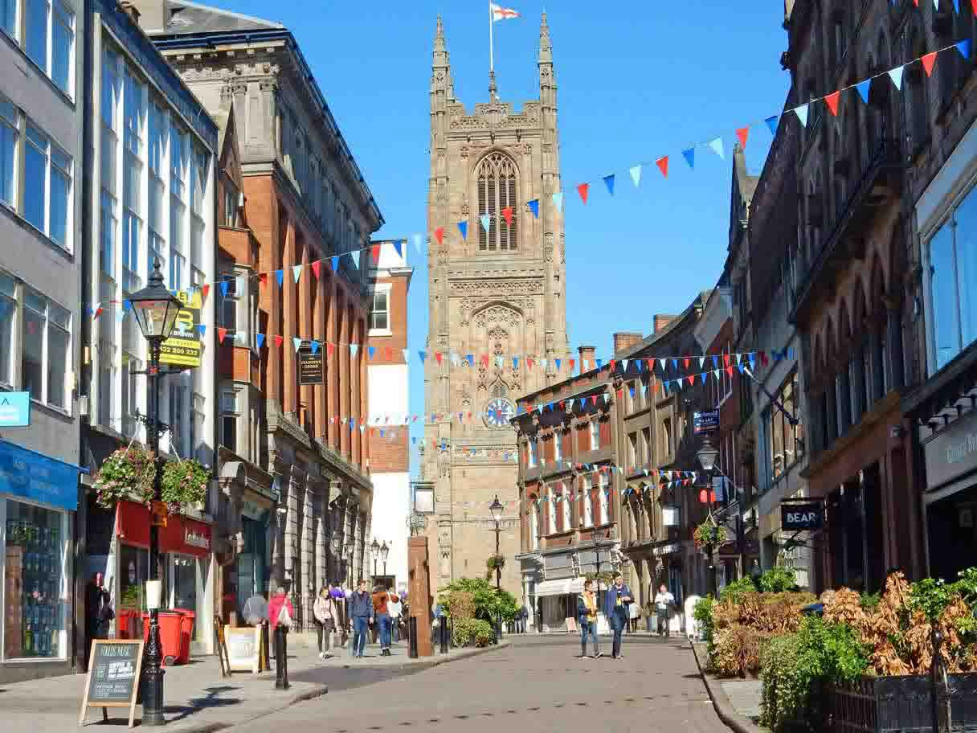
About the team | Derby City Public Health department offers a warm and friendly working environment. We are a small (and influential!) team of 30 led by the Director of Public Health, Dr Robyn Dewis. We have a range of commissioning responsibilities for health improvement services including substance misuse, 0-19 Public health nursing and sexual health. We have a Knowledge and Intelligence team who work across the department. They have recently undertaken a significant redevelopment of our Joint Strategic Needs Assessment to turn it into a live resource which can be used effectively for planning. We also lead and influence on a health improvement, healthcare public health and health protection by working with the ICS, Health and Wellbeing Board, NHS providers and others including schools, university. In partnership with Community Action Derby (our voluntary sector infrastructure organisation) we established the award-winning Derby Health Inequalities Partnership which brings together a range of community and voluntary partners to improve health, social capital and direct influence on statutory partners.

Slide 17
What’s different about this placement | well-established team with specific expertise in commissioning and strategic leadership. The Derbyshire Network encourages opportunities across all members, including DCHS and Derbyshire County Council, to maximise opportunities to achieve learning outcomes We have excellent working relationships with the voluntary sector which offering meaningful opportunities to achieve health promotion and community development learning outcomes (KA 5) We have strong relationships with University Hospitals Burton and Derby NHSFT, including a co-located Public Health Consultant expanding our Healthcare Public Health offer and providing opportunities to improve the Trust's health promotion offer. We have a supportive team, and registrars feel well connected with the team and attend (and contribute to) department meetings and are invited onto the Public Health Senior Management Team. We have excellent relationships with ICS colleagues creating opportunities to work at a system level . We have been successful in applying to host NHS Population Fellows for 2 years
Website Links | Derby City Joint Strategic Needs Assessment

Slide 18
Derbyshire county council
Name of Organisation | Derbyshire County Council
Training Network | Derbyshire
Base Address | County Hall, Smedley Street, Matlock, Derbyshire DE4 3AG. (additional bases in Chesterfield and Ripley)
Working arrangements | Flexible working arrangements with mix of office-based work and working from home. Matlock is accessible by train (direct services from Derby and Nottingham) and is within 20 mins of the M1, and within 60 mins travel time of large parts of the East Midlands, Sheffield and South Yorkshire, and Greater Manchester.
Description of Placement | Derbyshire covers a large geographic footprint, populated with market towns, rural villages and ex-mining communities. Health outcomes are mixed across the county, reflecting the diverse demographics and needs of the population. Collaborative working is vital to address local challenges, and a placement in Derbyshire provides an opportunity to work across a complex health and care system, with district and borough councils, voluntary sector organisations, and colleagues in Derby City Council. A focus on place is important in Derbyshire, and a well-established locality programme allows working alongside other place-based organisations and communities through our network of Health and Wellbeing Partnerships. We are part of the East Midlands Combined County Authority, with a newly elected Mayor, working with Derby City, Nottingham City and Nottinghamshire County on projects that will improve health outcomes across the area. The Public Health Department directly delivers a range of services, including the Live Life Better Derbyshire lifestyle service. The department has a range of commissioning responsibilities and hosts a health protection function on behalf of the Directors of Public Health in Derby City and Derbyshire County.

Slide 19
Description of placement | There is a strong focus in the department on taking action through the wider determinants of health, including financial security, employment and health and housing and health. The department is part of the Joined Up Care Derbyshire Integrated Care system that covers the geographic footprint of Derby City and Derbyshire County. Registrars are involved in all aspects working within a political environment, working alongside Elected Members, and attending Cabinet, Full Council, and Health and Wellbeing Board meetings to experience political decision-making.
About the Team | Public Health in Derbyshire is a large department, yet is a friendly and accommodating team. The role of registrars in the department is well recognised and well valued. The size of the team means that there is always exciting work happening across a wide range of public health priorities, giving registrars the opportunity to experience work in a busy department and presenting a range of opportunities to achieve learning outcomes. All Public Health Registrars are members of the Department’s Extended Leadership Team, and registrars who have completed the FPH membership exam are members of the Senior Management Team, providing opportunities to be a member of a senior leadership team and influence decision-making. There is an in-house CPD programme and monthly journal club that registrars are encouraged to both attend and deliver sessions. Training is supported by four Educational Supervisors, who work together to ensure that the placement delivers against the training and development needs of the individual. The department hosts trainees from other programmes, such as F2 doctors and GP registrars, allowing cross-programme collaboration and supervision opportunities. The department also actively supports wider public health workforce development.

Slide 20
What’s different about this placement | Public Health at Derbyshire County Council incorporates a range of council functions including disability and employment services and welfare rights, in addition to functions delivered through the Public Health Grant. The public health team commission and deliver services that meet the needs of diverse communities Registrars can experience frontline public health service delivery. We work in partnership with organisations across the Derbyshire Network, allowing registrars to work across the health and social care system, and maximise learning opportunities. We have a strong place-based focus led by our localities team who facilitate our engagement with communities. As an innovative department we recognise the value of input from a range of professions to improve health outcomes, and the department includes an embedded psychology and behavioural insights team. Derbyshire has world renowned countryside and the location of our department provides opportunities to be active in nature.
Website Links | About Public Health Derbyshire Joint Strategic Needs Assessment

Slide 21
Leicester City council
Name of Organisation | Leicester City Council
Training Network | Leicester, Leicestershire and Rutland (LLR)
Base Address | City Hall, Charles Street Leicester LE1 1FZ
Working arrangements | Flexible working arrangements with mix of office-based work and working from home. Most Public Health staff work in the office at least one or two days per week.
Description of Placement | Leicester is the most populous urban centre in the East Midlands. Our population is relatively young compared with England reflecting the student population and inward migration to the city. Leicester is one of the 20% most deprived districts/unitary authorities in England and about 23% (17,725) children live in low income families. We are a diverse city with around half of our population classifying themselves as belonging to an ethnic group that is not white. Life expectancy for both men and women is lower than the England average. Leicester City is a unitary authority headed by an elected Mayor. Each department has a lead elected councillor who acts as an advocate on behalf of their department to the rest of the council. The public health team is well recognised across the authority and with partners for the quality of its work/contribution particularly around using evidence and data to inform decisions.

Slide 22
Description of placement | We have excellent relationships across the council with other departments such as social care, education and housing and this enables public health principles to be embedded within usual council practice, it also provides opportunities for cross department working. We have strong links with our two local universities - University of Leicester and Demontfort University, with the local voluntary sector, with NHS colleagues and with our Integrated Care Board – all of which allows a diverse range of training opportunities for registrars.
About the Team | The Public Health team is an awarding winning team recognised by the Association of Directors of Public Health for its “extraordinary show of resilience, dedication, creativity and hard work” during covid and its “positive, caring, capable and determined” approach. Rob Howard is our DPH and is supported by 5 consultants in Public Health. The full team is split into three smaller teams: •EPIC’ (Engagement, partnerships, inequities and communities) is led by consultants Kath Packham and Laura French and works on healthcare public health, long term conditions, community engagement, social isolation, health in all policies, the 0-19 healthy child programme, sexual health and NHS health checks •‘IPAC’ () which is headed up by Mary Hall and Liz Rodrigo and covers health protection, substance use services, mental health, contracts, clinical governance and oral health •Prevention- led by Jo Atkinson and encompassing ‘Livewell’ which is our in-house lifestyle service, smoking cessation, whole systems approach to healthy weight and food and fuel poverty Registrars have an opportunity to work across and within teams depending on their area of interest and curriculum requirements.

Slide 23
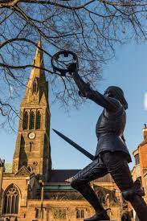
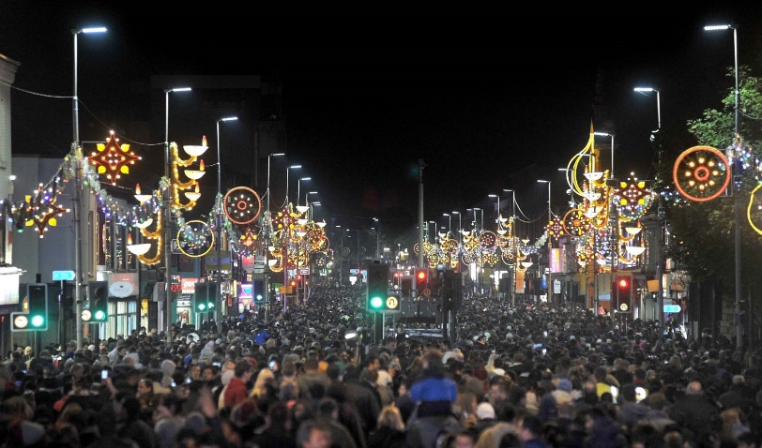
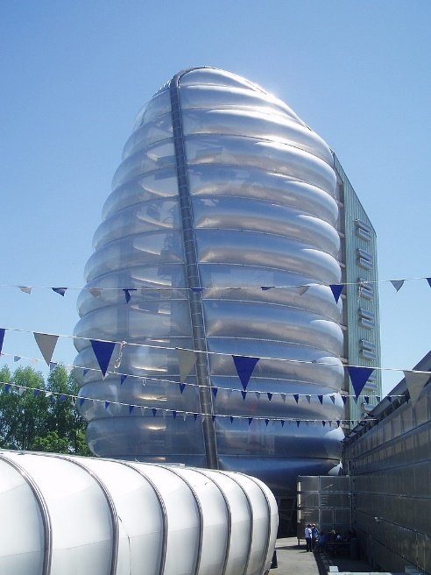
What’s different about this placement | Our links and relations within the council and with external partners means we have a huge range of opportunities that registrars can get involved in. In addition to our main teams’ areas of work, there are also several areas of work which cut across the teams and which everyone can get involved in working on, including research, sustainability and workforce development. Recent areas of work for registrars have included work on HIV late diagnosis, latent TB screening, Health Needs Assessment for people seeking Asylum, and maternity equity work on early antenatal booking. Plus many, many more…
Website Links | Joint Strategic Needs Assessment (leicester.gov.uk)

Slide 24
Leicestershire County Council
Name of Organisation | Leicestershire County Council
Training Network | LLR
Base Address | County Hall Glenfield Leicestershire
Working arrangements | Hybrid (office and home)
Description of Placement | Leicestershire is an upper tier local authority with a resident population of approximately 713,000 (2020) and increasing; by 2043 it is estimated that the population will have grown by 23% to nearly 870,000. Compared with England, our population is older and 91% belong to white ethnic groups, followed by Asian (6.3%), Mixed or Multiple Ethnic (1.7%) and Black ethnic groups (0.6%). Overall, 69% of the population live in areas classed as Urban City and Town, while 19% live in area classed as Rural Town and Fringe and the remaining 12% live in areas classed as Rural Village and Dispersed. Leicestershire is not deprived overall, though four neighbourhoods in the county fall within the most derived decile in England. The M1 motorway transects the county and East Midlands international airport and part of the East Midlands Freeport are within our boundary.

Slide 25
Leicestershire County Council
About the Team | There are over 160 staff in the Public Health department with both commissioning and provider functions. We have 5 Consultants in Public Health, two Assistant Directors and the DPH is also the DPH for Rutland County Council. Two of our consultants are also academics at the Universities of Nottingham and Leicester. Leicestershire County Council is a research active organisation and has funding from the National Institute for Health and Care Research (NIHR) to be a Health Determinants Research Collaboration (HDRC) - https://resources.leicestershire.gov.uk/health-and-wellbeing/nihr-health-determinants-research-collaboration-leicestershire/about-hdrc-leicestershire#about-hdrc Our provider arm includes: a weight management service (https://www.leicestershirewms.co.uk/), stop smoking service (https://www.quitready.co.uk/), oral health improvement team and community-based Local Area Co-ordinators and Recovery Workers. We have an active Healthy Tots (https://www.leicestershirehealthytots.org.uk/) and Healthy Schools programme (https://www.leicestershirehealthyschools.org.uk/) and work closely with our active partnership Active Together (https://www.active-together.org/). We also have a community infection and control team.

Slide 26
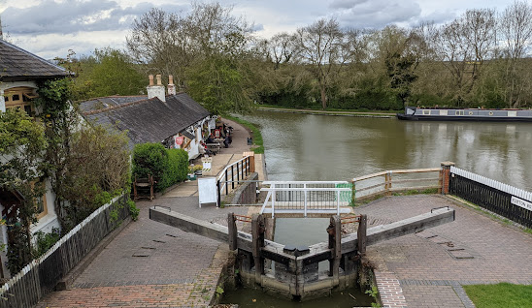
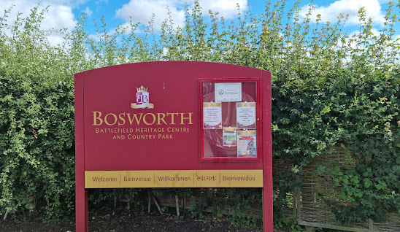
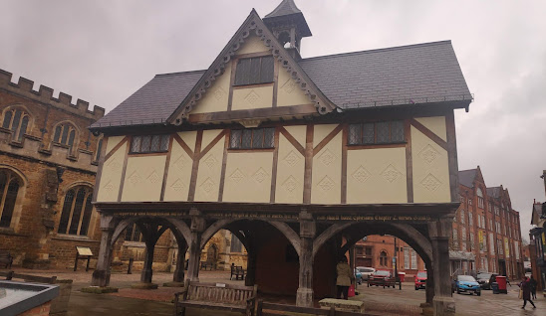
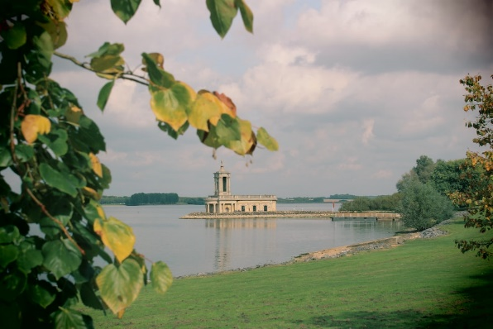
What’s Different about this placement | We have a mix of provider and commissioning teams and our consultants work support work in the ICS/acute and community trusts, and also higher education institutes in the region. This means that trainees can have exposure to a broad range of public health functions, developing skills across all domains of public health practice.
Website links | Welcome | Leicestershire County Council Our strategy can be found here (https://www.leicestershire.gov.uk/sites/default/files/field/pdf/2022/7/28/public-health-strategy-2022-27.pdf)

Slide 27
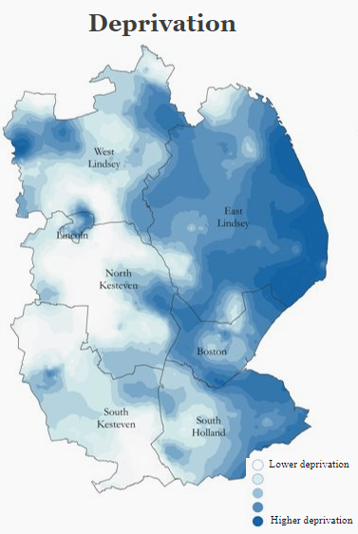
Lincolnshire County Council
Name of Organisation | Lincolnshire County Council
Training Network | Lincolnshire
Base Address | County Offices, Newland, Lincoln, LN1 1YL
Working arrangements | Hybrid (office and home)
Description of Placement | Lincolnshire is a large rural and coastal county - the 4th largest in England. The resident population is 768,400 (Census, 2021) and the GP registered population is 816,350 (ICS Joined Intelligence dataset 2024). The population is diverse, but there is a significant focus on health inequalities as many of our coastal areas (as well as pockets in Gainsborough, Lincoln and Boston) are among the most deprived in England. The population is older than the England average, with 23% of the population currently aged 65 and over, and this expected to increase to 41% by 2043. 89.2% of the population is white British and the dominant ethnic minority group is Eastern European migrants who are concentrated around Boston and in parts of Lincoln.

Slide 28
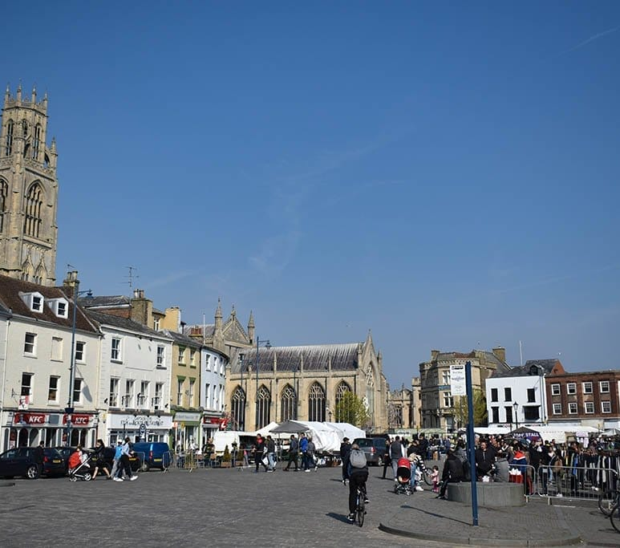
Lincolnshire County Council
Description of Placement Continued | The Public Health team in Lincolnshire is relatively large and we work closely with other parts of the Council as well as District colleagues, local NHS providers and the Integrated Care Board, criminal justice partners, the University of Lincoln and the local Voluntary, Community, Faith and Social Enterprise sector. Lincolnshire is of interest because it is one of few co-terminus areas across England (where all major agencies cover the same geography).
About the Team | The Public Health team at LCC are an enthusiastic, caring and hard working group of people who are passionate about making life better and helping others. The team offers a collaborative working environment, and with over 80 team members with a range of interests, backgrounds and experiences you are bound to find both people with similar interests and people from whom you can learn more about new areas of practice. Our team works in 6 broad portfolios: 1) Prevention and Health Inequalities (led by Andy Fox), 2) Health Protection, 3) Health and Care Systems, Partnerships and Pathways (led by Tony McGinty), 4) Wider Determinants (led by Anne-Marie Scott), 5) Public Mental Health, and 6) Intelligence, Research and Innovation (led by Lucy Gavens). Our Director of Public Health is Derek Ward.

Slide 29
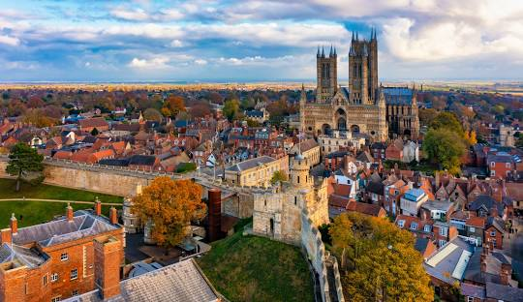
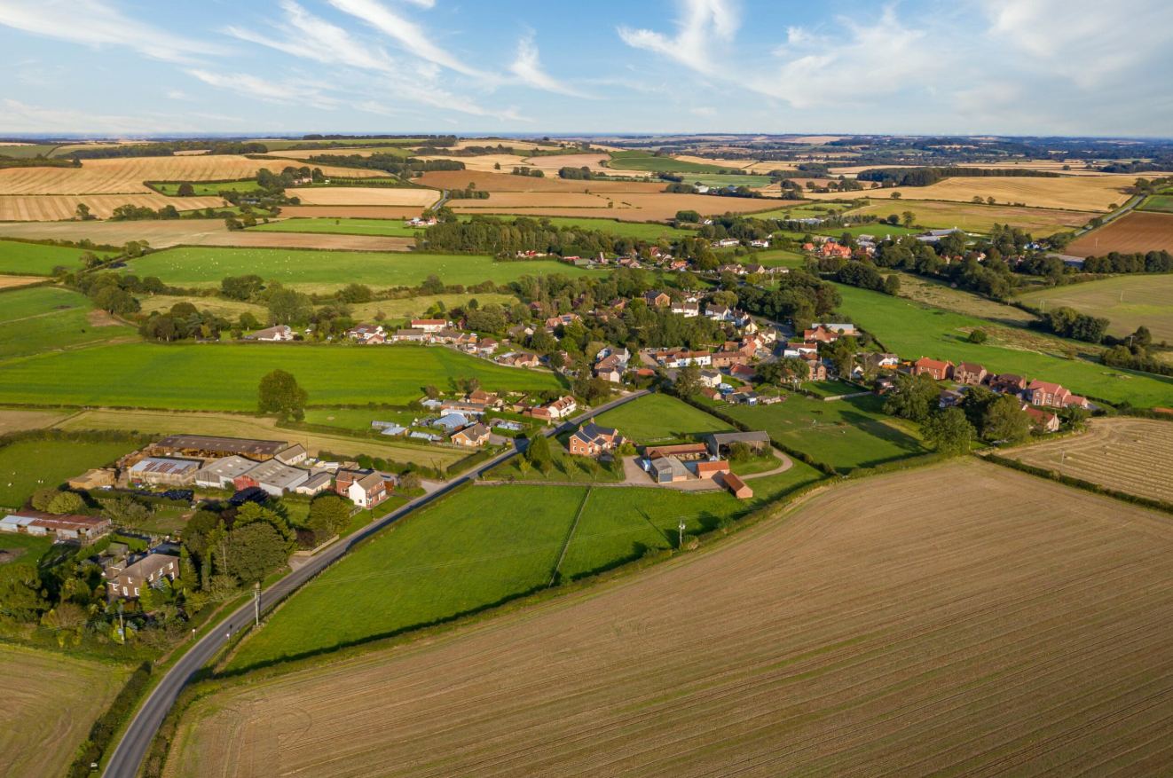
Lincolnshire County Council
What’s different about this placement | Lincolnshire has several areas of strength which makes it stand apart from other places, including: Our Health Protection Team, who provide a range of support to local organisations including infection prevention control, vaccination advice, clinical governance and much more. A strong relationship with the Integrated Care Board across several areas including Mental Health, Dementia, Learning Disability and Autism, and Prevention and Health Inequalities. Access to an advanced linked dataset for our GP registered population, enabling advanced analytics to guide population health activity and design targeted interventions to improve health outcomes and reduce health inequalities.
Website Links | Learn more about Lincolnshire and our work through the Lincolnshire Health Intelligence Hub.

Slide 30
North Northamptonshire Council
Name of Organisation | North Northamptonshire Council
Training Network | Northamptonshire
Base Address | Sheerness House, 41 Meadow Road, Kettering, NN16 8TL
Working arrangements | Hybrid (office and home)
Description of Placement | North Northamptonshire Council was created in 2021 when four district councils and half of the former Northamptonshire County Council merged to become one of the largest unitary councils in England. Our vision is that everyone has the best opportunities and thrives, including living active and fulfilled lives. In 2021, our population was 359,500, a 13.5% increase since 2011. Our most significant population growth is in those aged over 65, who make up 30% of our population. We are becoming a more diverse population in the 2021 census 80% of our residents said they were born in England. Our most deprived areas are in Corby, Kettering and Wellingborough. Whilst East Northamptonshire is more affluent overall, some residents experience rural isolation and fuel poverty. We are committed to collaborative working to improve health and reduce health inequality. We work closely with colleagues in West Northamptonshire Council and across the health and care system, so registrars based with us have the opportunity to contribute to systemwide work from early training.

Slide 31
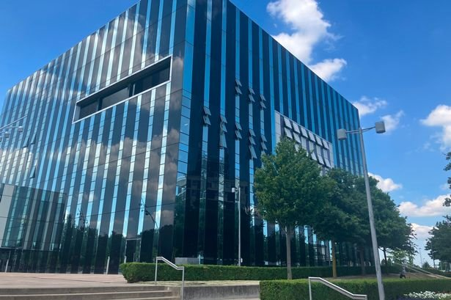
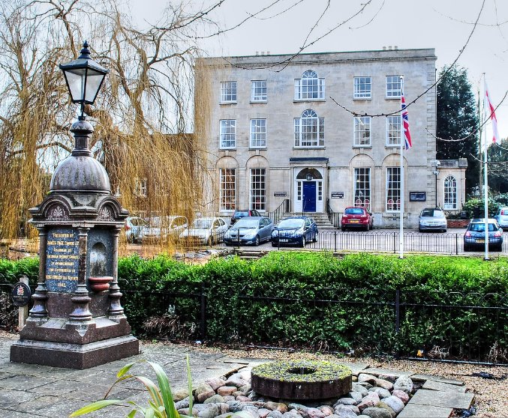
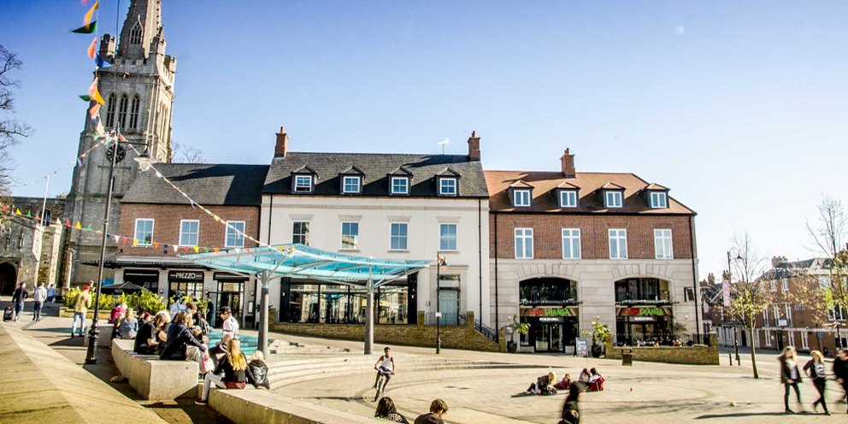
NORTH NORTHAMPTONSHIRE Council
About the Team | We are a vibrant team of 76 led by the Director of Public Health (DPH), Communities and Leisure Dr Jane Shaw. A Deputy DPH, an Assistant DPH and two consultants in public health support the DPH. Our team has commissioning, strategic and provider functions, so registrars have a broad range of opportunities. Our training reputation is growing. We’re currently supervising three public health registrars; we also support sexual health registrars and GP registrars.

Slide 32
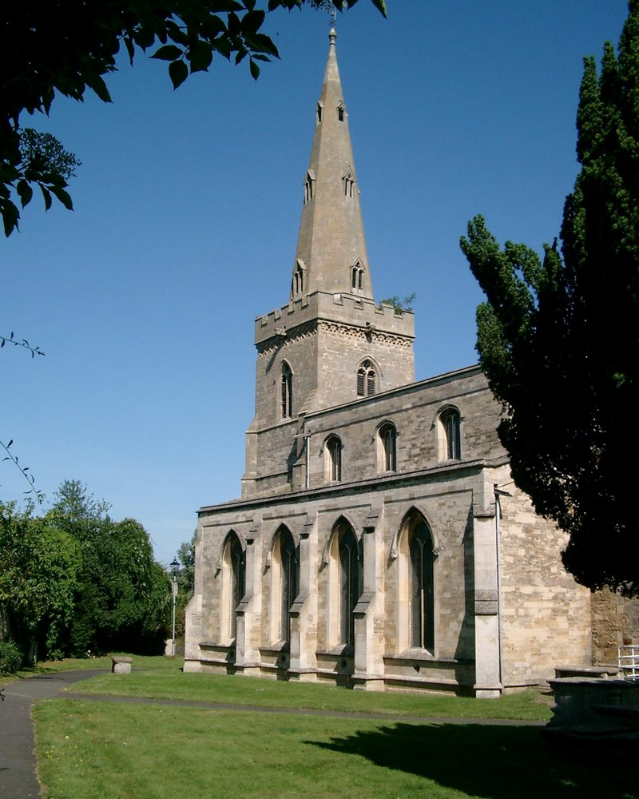
North Northamptonshire Council
What’s different about this placement | We are passionate about education and training, and this infuses our work. We will maximise your opportunities to develop your public health practice alongside our CPD programme and exam support. As your confidence grows, we will support you to lead CPD sessions as well as participate in them. Our educational supervisors have experience of working in a range of training locations including local authorities, healthcare settings, and higher education. This experience helps us to create a supportive training environment to help you achieve your aspirations. We have active research collaborations with our local university, the University of Northampton and strong links with the University of Nottingham. We can facilitate opportunities for you to participate in teaching and mentoring of MPH students. Our work with NHS partners is developing at pace, and we’ll shortly have registrars embedded in NHS Trusts to lead their prevention strategies. Current registrar projects include exploring neonatal mortality, working across the system on race equity, convening a health and care workstream on substance misuse and leading the tobacco strand of our health and wellbeing strategy.
Website Links | Health and wellbeing| North Northamptonshire Council Reports and assessments | North Northamptonshire Council About the Health and Wellbeing Board | North Northamptonshire Council

Slide 33
West Northamptonshire Council
Name of Organisation | West Northamptonshire Council
Training Network | Northamptonshire
Base Address | Sheerness House, 41 Meadow Road, Kettering, NN16 8TL
Working arrangements | Hybrid (office and home)
Description of Placement | West Northamptonshire Council was created in 2021 when three districts and half of the former Northamptonshire County Council merged to become a unitary council. In 2022 our population was 429,013.

Slide 34
West NORTHAMPTONSHIRE Council
About the Team

Slide 35
West Northamptonshire Council
What’s different about this placement
Website Links | West Northamptonshire Joint Strategic Needs Assessment

Slide 36
Nottingham City Council
Name of Organisation | Nottingham City Council
Training Network | Nottinghamshire
Base Address | Loxley House Station Street Nottingham
Working arrangements | Hybrid (office and home)
Description of Placement | Nottingham city is one of England’s core cities. It is a vibrant urban centre with a rich history of rebels, industry and culture. However, it faces significant public health challenges. Residents have some of the lowest healthy life expectancy in England. This means that people living in Nottingham not only live shorter lives than in other similar areas but spend more of that time in poor health or living with disability. Nottingham City Council has a tight boundary containing 323,600 residents (Census 2021). The population is comparatively young and the city attracts a large population who work, study, shop and socialise here bringing some unique benefits and challenges. Nottingham’s biggest challenge is the high levels of deprivation residents experience. These disparities are visually stark, with over half (55.2%) of Nottingham’s residents living within the top 20% of the most deprived neighbourhoods nationally. The city’s socio-economic profile reveals a complex tapestry of needs and issues. Nottingham is home to a richly diverse population, with communities from various ethnic and cultural backgrounds. This diversity brings vibrancy to the city but also results in complex health and social care needs.

Slide 37
Nottingham City Council
Description of Placement | The public health team works closely with various parts of the council such as planning, licensing, housing, trading standards, sport and leisure, and the carbon neutral team. We also have a positive relationship with our Place Based Partnership and Integrated Care System as well as partners such as the Violence Reduction Partnership, Nottingham University Hospitals, and our two universities. This allows us to offer registrars an opportunity to be involved with a great diversity of work.
About the Team | The Public Health team in Nottingham has, over the last couple of years, been shortlisted for local government awards for it’s partnership work and won a local government workforce award and ADPH Innovative Practice Award. The Public Health team has expanded rapidly over the last few years with now approximately 40 staff within the public health team. Despite the rapid expansion, consultants and the Director of Public Health remain very accessible to staff and registrars. Registrars become members of a relevant team attending regular, in-person team meetings and are invited to participate in quarterly public health away days. The Deputy Director of Public Health along with 3 Consultants in Public Health provide the educational supervision for registrars. These individuals alongside three Public Health Principals form the Senior Leadership Team with registrars invited to attend SLT meetings and our monthly programme board to observe an input into how the team functions.

Slide 38
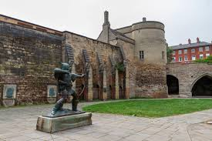
Nottingham City Council
What’s Different about this placement | Nottingham has a wide range of opportunities for registrars at all stages of training. Alongside a wide range of commissioned services, public health works closely to deliver it’s function through partnership working within and outside of the council. Registrars have the opportunity to complete healthcare public health project placements with Nottingham University Hospitals and Notts Healthcare Trust while supported by an ES in Nottingham City Council. They also have the opportunity to complete projects with the Violence Reduction Partnership and Financial Resilience Forum as well as in the future with the East Midlands Combined Authority. Registrars are treated as peers and trusted with important topics such as the recent creation of a Gambling Strategy or support in commissioning of sexual health services. Through internal CPD and collaboration with two universities, there are opportunities to work with academics including for senior registrars, co-supervision of student placements.
Website links | DPH report 2022/23: 10 years of public health in local authority Health and Wellbeing Strategy JSNA Dashboard
For a conversation about placement opportunities please contact david.johns@nottinghamcity.gov.uk

Slide 39
Nottinghamshire county council
Name of Organisation | Nottinghamshire County Council
Training Network | Nottinghamshire
Base Address | County Hall, West Bridgford Nottingham NG2 7QP
Working arrangements | Hybrid working arrangements are in place with equipment provided to facilitate this. Hot desks are provided in County Hall with dedicated area for Public Health however, there is also the opportunity to work from a number of local offices.
Description of Placement | Nottinghamshire is a diverse County with a population of 824800. There is a mix of urban and rural areas, with significant areas of deprivation and health challenges. Nottinghamshire is an upper tier local authority and works with the districts, boroughs, East Midlands Combined Authority and the NHS to deliver on the public health agenda. Public Health is part of the Place Department. The council has an engaged political leadership, an active Health and Wellbeing Board, and a commitment to cross council and partnership working which delivers great outcomes for people in Nottinghamshire. Our work with NHS partners includes the integrated care board, three place-based partnerships and three large NHS trusts. Registrars are supervised by one of the consultants in Public Health however, they will be given the opportunity to work across a range of different agendas. Prior to the placement an initial conversation with the training location will identify learning outcomes that you need to achieve. Depending on identified learning outcomes opportunities are provided to gain involvement in needs assessment, commissioning, performance management, procurement, quality assurance and working directly with providers.

Slide 40
Nottinghamshire county council
About the Team | The Director of Public Health has oversight of a supportive and engaged team of approximately 60 public health staff. The Deputy Director of Public Health along with up to 5 Consultants in Public Health provide the educational supervision for registrars. This placement provides the opportunity to work across a range of agendas and teams to gain a breath of experience including support from the well-established public health intelligence team and the potential to link to Sherwood Forest Hospital Trust. As a training placement we are strongly committed to the development of future public health professionals and support the training of registrars, F2’s, public health apprentices, students and Nottinghamshire County Council graduate training programme. The registrars have developed a strong peer support network that provides a safe collegiate environment to learn. From 2025 onwards Public Health will come together with the wider communities team which will provide further opportunities to ensure training across the building blocks/wider determinants of health and out community functions

Slide 41
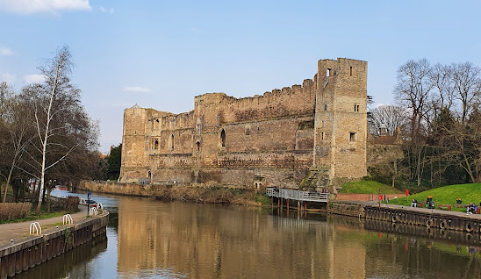
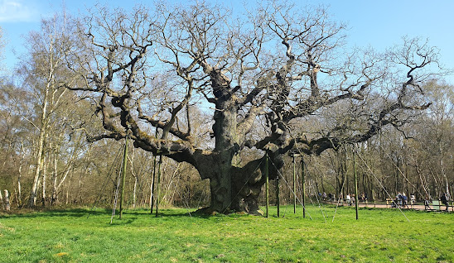
What’s different about this placement | Working in a large friendly team provides opportunities to be involved in the whole of the commissioning cycle including co-production. All staff have been trained in using coaching approaches in conversations and staff development is core to the values of the department. Post diplomate examinations registrars became part of the full senior leadership team.
Website links | Home - Nottinghamshire Insight Home | Nottinghamshire County Council

Slide 42
NHS Trusts

Slide 43
Nottinghamshire Health Care Trust
Name of organisation | Nottinghamshire Healthcare NHS Foundation Trust
Training Network | Nottinghamshire Training Network
Base Address | Duncan Macmillan House (DMH) , Porchester Road, Nottingham, NG3 6AA
Working arrangements | We offer flexible working arrangements with some home working and the offer of office space at DMH. There may also be a requirement to work within clinical teams, depending on the project.
Description of placement | We are a large mental health and community healthcare Trust. We also provide offender healthcare across a number of areas in the Midlands. We offer a range of opportunities that are at service, Trust, ICS and Place Based Partnership level. Projects and areas of work are identified in line with individual training needs and have included: -Strategy development, evaluation and implementation: Examples of work to date include a health and wellbeing strategy for the prison setting and also the development of the Trust’s prevention strategy. -Clinical pathway development and service improvement: This has included the development and implementation of the ‘dual diagnosis’ pathway for Nottingham and Nottinghamshire that supports people with substance use and mental health issues. -Service and economic evaluation: This has included evaluation of the new dual-diagnosis pathway and impact of a peer-support worker model. -Service improvement and health equity: We have offered projects looking at mental health presentations in the local acute Trust Emergency Department as well as opportunities to identify and respond to health inequalities in clinical services.

Slide 44
 | -Evaluation of technologies: We have a programme of work that looks at use of new technologies in our clinical services and appraises potential for benefit. An example includes the use of continuous glucose monitoring for our patients in the inpatient setting. -Systems working and leadership: We are actively involved in Trust, ICS and Place-Based Partnership work around health inequalities and offer a range of projects related to this area of work. This includes improving outcomes for people experiencing Sev
About the team | Our training opportunities sit within the Trust’s Population Health Unit. This supports the Trust and the system in relation to population health and improving outcomes for people receiving our care and services. In this unit we have one placement (clinical) supervisor (Dr Chris Packham -Associate Medical Director, GP and former DPH for Nottingham City) with an intention to recruit additional CPH capacity in the future. The team also includes a number of analysts, a Public Health Specialist and Psychiatrists. We work closely with our colleagues in Nottingham City Council and Nottinghamshire County Council. At present the former provides educational supervision for registrars looking for training opportunities across local authority and the healthcare trust.
What’s different about this placement | Our placement offers the opportunity to work at both operational and strategic level in the Trust and the wider system. Projects include working directly with patients, clinicians and commissioners and are aligned to Trust and system priorities.
Website Links | To find out more about our location and the work we do as a Trust please see: https://www.nottinghamshirehealthcare.nhs.uk To read our Trust strategy please see: https://www.nottinghamshirehealthcare.nhs.uk/vision-values-and-strategic-objectives

Slide 45
Derbyshire Community Health Services
Name of organisation | Derbyshire Community Health Services NHS Foundation Trust
Training Network | Derbyshire Training Network
Base Address | Ash Green Learning Disability Centre, Ashgate Road, Ashgate, Chesterfield, Derbyshire S42 7JE
Working arrangements | We offer flexible working arrangements with home working and a wide range of bases across Derby and Derbyshire.
Description of placement | DCHS NHS FT is a fast-paced provider organisation with a long standing commitment to applying a public health approach to its ways of working. The Trust actively encourages continuous improvement and innovation in practice. Within this context, registrars have ample opportunity to show initiative in their work leading significant influential projects of organisation and System importance. Registrar’s are well supported to achieve their Healthcare Public Health and wider learning objectives and gain a rounded understanding of the operating opportunities and challenges faced in an operational NHS environment.
About the Team | Jayne Needham Director of Strategy, Partnership and Population Health/Consultant in Public Health is educational supervisor for all public health registrars on placement in the trust. Jayne is supported by Matt Eves, a Population Health Management Specialist with experience across private and public services, with the latter spanning Local Authority, acute and community health services, including commissioning, healthcare operations management, and more recently, corporate roles.

Slide 46
Derbyshire Community Health Services
About the Team | Working alongside Jayne and Matt are a number of other health professionals whose work is aligned to prevention, reducing health inequalities and population health management. These include clinical psychology, psychological insights, health coaching, EDI and organisational Development professionals, medical support workers and data analytical capacity
What’s different about this placement | Current SpR’s had this to say about a placement with DCHS: Fantastic opportunity to gain experience in a Provider Trust - the ‘other side’ Fast-paced and dynamic Lots of opportunities for broad range of projects – beyond just meeting Healthcare Public Health learning objectives Opportunities for system wide work due to DCHS’s position within the integrated Care System and its strong partnerships with other NHS providers including Acute hospitals in Derby and Chesterfield. SpR’s will be supported to undertake collaborative working both with other provider and ICB colleagues Small team – allows for great team working Strong Board level commitment to the Public Health agenda Working with other team members/registrars encouraged
Website links | Home :: Derbyshire Community Health Services (dchs.nhs.uk)

Slide 47
Government agencies

Slide 48
UNO Network
Name of Organisation | UNO network (United Kingdom Health Security Agency (UKHSA), Office for Health Improvement and Disparities (OHID) NHS England (NHSE)
Training Network | UNO
Base Address | Registrars are based at Seaton House , City Link, London Road, Nottingham NG2 4LA. This office is located in the centre of Nottingham, very close to Nottingham railway station and its tram stop. UKHSA and OHID staff are based at Seaton House. NHSE staff are based at offices across the Midlands including Seaton House, Leicester and Birmingham.
Working arrangements | Hybrid working – registrars will be expected to work in an office for at least 40% of the working week. Appropriate IT will be supplied to facilitate remote working. Attendance in person at team awaydays and events will be required.
Description of Placement | Public Health England (PHE) was the national public health agency for England, employing around 5000 staff. PHE was disestablished in October 2021 and its staff and functions distributed to three organisations (1) UKHSA staff work in health protection, protecting the public from microbiological, radiological, chemical and environmental hazards. (2) OHID staff work in health improvement, promoting healthier lifestyles in alcohol, tobacco, drugs and sexual health; and multiagency working to improve the wider determinants of health such as employment, education, environment and transport. (3) Staff who transferred to NHSE work in healthcare public health, providing support to the commissioning of health services, with a focus on intelligence, evidence of effectiveness, health inequalities, and working with clinicians and managers on service re-design and care pathways. We were a single training network in PHE East Midlands and we have maintained this network since we were split between three organisations. There is very close working between the three organisations and our registrars work on projects for each organisation.

Slide 49
About the Team | There are around 20 consultants working for UKHSA, OHID or NHSE in the East Midlands. Our consultants often sub-specialise and are experts in their particular field of practice. There is a public health training lead in each of the three organisations.
What’s different about this placement | All public health registrars are required to spend at least three months wte at UKHSA on their health protection placement, within the first two years in training. This placement, along with successful completion of the Diplomate exam, is required to go on the out-of-hours on-call rota for health protection, which is mandatory for successful completion of the training programme. Some registrars will wish to spend additional time in health protection, generally at the end of training, if they intend to work in health protection as a consultant. Around six registrars are based with the UNO network as their substantive placement, with NHS England as the host organisation, generally for one to two years. We offer a very different training experience to that available within local authorities: - Within our network we can offer projects that cover each learning outcome in the curriculum. - We can offer projects that integrate health protection, health improvement and healthcare public health. - Work at OHID is predominantly around formation of policy. - NHS England has more of a focus on healthcare public health than local authority placements. - Many of our consultants have England-wide responsibilities, and thus there are opportunities to lead and contribute to work at a national level. - The governance and culture of the NHS (NHSE) or the Civil Service (OHID and UKHSA) is very different to that of local government. Recent projects by our registrars include: - A review of the evidence of effectiveness for robotic surgery. This review was conducted jointly with clinical fellows from the East Midlands and West Midlands Clinical Senates. - A needs assessment for children and young people with eating disorders - Review of health inequalities in respiratory disease in the Midlands - Range of projects relating to neonatal mortality and infant mortality - Review of data and evidence relating to avoidable mortality - Part of the team investigating a screening incident Our registrars have had a number of projects published in peer-reviewed journals. Including: - International Journal of Eating Disorders 2023; 56: 282-287 - BMJ Leader 2024; 8: 264-267 - BMC Medical Education 2024; 24: 57
Website Links | www.gov.uk/government/organisations/office-for-health-improvement-and-disparities www.gov.uk/government/organisations/uk-health-security-agency www.england.nhs.uk

Slide 50
Academic placements

Slide 51
University of NOTTINGHAM
Name of Organisation | Nottingham Centre for Public Health and Epidemiology (NCPHE), University of Nottingham
Training Network | Nottinghamshire
Base Address | Clinical Sciences Building, City Hospital Campus, NG5 1PB
Working arrangements | Hybrid (office and home)
Description of Placement | We see academic public health as an integral part of public health service, and encourage trainees at all stages to link to us proactively throughout the “life course” of their training. NCPHE is a research and teaching centre at the University of Nottingham within the Lifespan and Population Health unit. NCPHE offers opportunities to develop academic skills in public health research and teaching. We encourage trainees to work with us in advance to plan a tailored programme of work that harnesses the extraordinary range of opportunities across BSMS and its host universities, the NIHR, and partner institutions in local government, NHS and social care. Combined placements are encouraged (e.g. Health Protection Teams, NHS Trusts, Local Government) as in our experience this can add value both for the trainee and the organisations. NCPHE offers a suite of highly regarded Masters in Public Health (Public health, Global Health and Health Research), and a range of postgraduate courses and modules offered externally as CPD. Our research focuses in four main areas: clinical epidemiology, evidence-based healthcare, the commercial determinants of health and global health. In addition, we work closely with the Centre for Academic Primary Care where which includes injury prevention and biobehavioural approaches research groups.

Slide 52
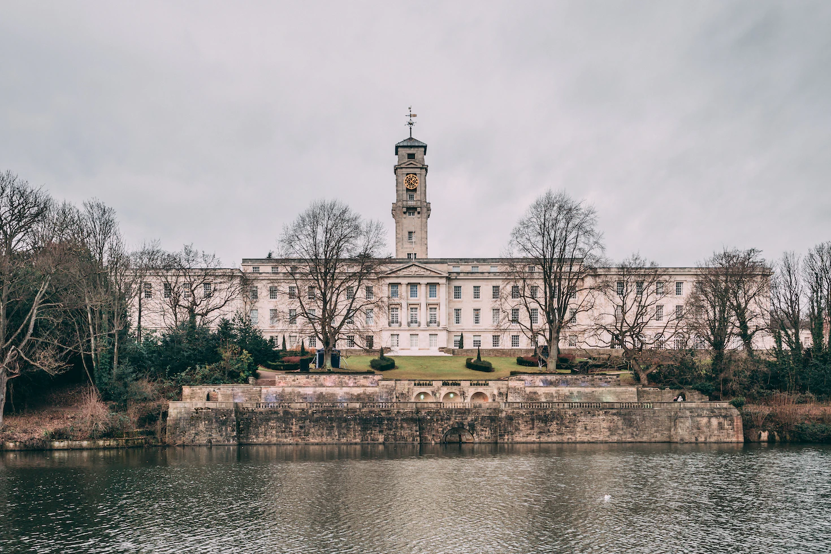
About the Team | NCPHE is successful, growing research centre at the University of Nottingham, which focuses on applied research into public health and primary and community care. It comprises a team of about 50 staff from a wide range of disciplines relevant to public health, including public health, epidemiology, data science, statistics, psychology, sociology, health economics and evaluation of health and social care interventions using a range of methodologies. In addition, we support approximately 25 PhD students and 100 Master’s level students. We have strong national and international collaborations. The Nottingham Centre for Public Health and Epidemiology at the University of Nottingham holds a full Institutional-level Accreditation by the Agency for Public Health Education Accreditation (APHEA). The MPH course curriculum is fully accredited by APHEA and the Institute for Health Promotion Education (IHPE).
What's different about this placement | Opportunities to develop competencies in applied health research and to get your work published in peer-reviewed journals. Excellent opportunities in multidisciplinary research and a wide range of methodological approaches, including both quantitative and qualitative, using primary and secondary data. Training in involving the public in research. Strong commitment to researcher development Hybrid working arrangements will be supported and in addition to the City Hospital base there is desk space accessible on the main university campus. Training in teaching methods and the opportunity to work towards Advance HE recognition.
Website links | https://www.nottingham.ac.uk/medicine/about/divisions-and-units/epidemiology-and-public-health/index.aspx https://www.nottingham.ac.uk/medicine/about/divisions-and-units/primary-care/index.aspx

Slide 53
University of LEICESTER
Name of Organisation | University of Leicester
Training Network | Leicestershire
Base Address | George Davies Centre, University Road, Leicester, LE1 7RH
Working arrangements | Hybrid (office and home)
Description of Placement | We will work with registrars to develop bespoke academic placements which meet their learning needs and career goals. These can incorporate research, teaching, and experience of public engagement and outreach. The Department of Population Health Sciences hosts a number of research groups undertaking world-leading research on topics of public health importance. This includes chronic disease epidemiology, genetic epidemiology, cohort study design and management, environmental public health and sustainability (including a Health Protection Research Unit in environmental exposures) and healthcare quality and safety. We have strong links to clinical colleagues in primary and secondary care, including through the Leicester NIHR Biomedical Research Centre, and to local authorities through the Leicestershire NIHR Health Determinants Research Collaboration. We also have strong international collaborations and support research and capacity building in sub-Saharan Africa and elsewhere. Leicester Medical School has a strong public health theme running through the curriculum, is leading the way in developing interprofessional public health education for undergraduates and undertakes a range of medical education research. Registrar involvement in teaching is warmly welcomed and training will be provided. groups.

Slide 54
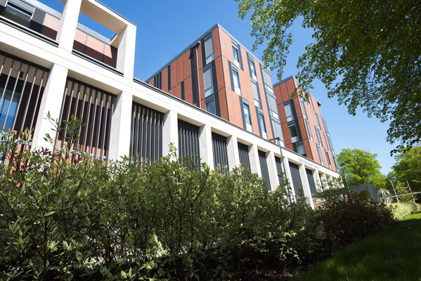
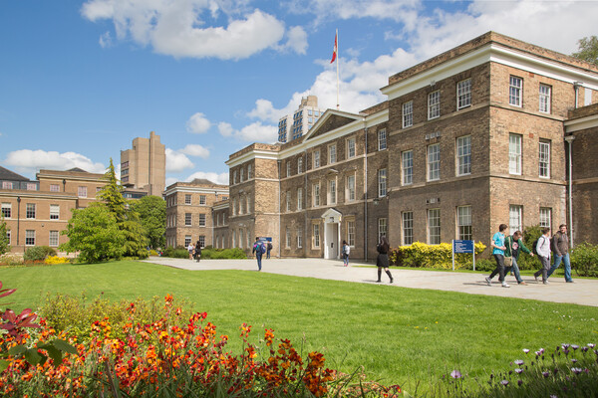
About the Team | The Department of Population Health Sciences is a multidisciplinary, research-intensive department of over 100 staff and postgraduate students. Our research funding comes from the Medical Research Council, Wellcome, NIHR, and a range of other charitable funders and industry collaborations. We work closely with UK and international collaborators. We are a friendly and welcoming place to work, committed to positive working culture, career development and diversity and equity, including hosting a doctoral training programme with dedicated space for researchers from low- and middle-income countries.
What's different about this placement | Help to answer important public health questions and share what you learn with the world! Develop and apply all of your public health skills in a different setting Gain experience of a range of research methods, datsets and disciplines, including quantitative and qualitative approaches Support for writing and publishing peer-reviewed journals and presenting at academic conferences Track record of supporting and developing researchers including registrars to win external research funding and obtain permanent academic positions
Website links | Research | Department of Population Health Sciences | University of Leicester

Slide 55
National placements

Slide 56
National Placements
Registrars may apply for Nationally Available Training Placements (NATPS) with the support of the Training Programme Director. These placements offer opportunities for registrars to acquire specific additional or contextual experience at a national level and develop specialist leadership knowledge and skills. The list of current NATPs on offer can be found on the faculty of public health website .
www.fph.org.uk/training-careers/specialty-training/training-placements/nationally-available-training-placements/.

