Slide 1
Public Health Training in the East Midlands
August 2025

Slide 2
The next 5 years…
Phase 1
Phase 2
ST1
ST2
ST3
ST4
ST5
MPH
DFPH “Part A”
Health Protection placement
?MFPH “Part B”
MFPH “Part B”
Health protection “on call”
Out of training placements
Rotate to new placement
“Acting up”
Phase 1
Phase 2
MPH
DFPH
(MFPH)
Phase 1 LOs
Satisfactory progression (curriculum)

Slide 3

https://www.fph.org.uk/media/4ojeo5bk/public-health-curriculum-2022-v13_final.pdf
10 Key Areas
Key Area 1:Use of public health intelligence to survey and assess a population’s health and wellbeing
Key Area 2: Assessing the evidence of effectiveness of interventions, programmes and
services intended to improve the health or wellbeing of individuals or populations
Key Area 3: Policy and strategy development and implementation
Key Area 4: Strategic leadership and collaborative working for health
Key Area 5: Health Improvement, Determinants of Health, and Health Communication
Key Area 6: Health Protection
Key Area 7: Health and Care Public Health
Key Area 8: Academic Public Health
Key Area 9: Professional personal and ethical development (PPED)
Key Area 10: Integration and Application of Competences for Consultant Practice

Slide 4
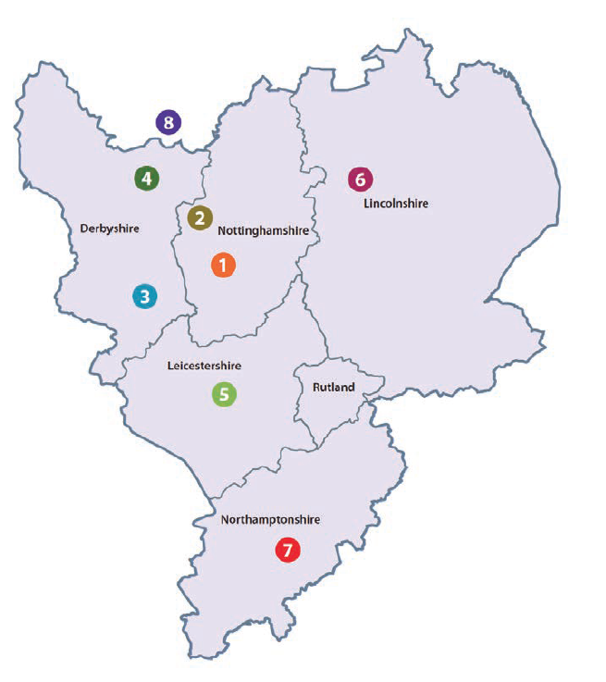
Training Locations
Nottinghamshire
Nottingham City Council
University of Nottingham
Derbyshire
3. Derby City Council
4. Derbyshire County Council
Leicestershire
5. Leicester City Council
Leicestershire County Council
University of Leicester
De Montfort University
Lincolnshire
6. Lincolnshire County Council
Northamptonshire
7. West Northamptonshire Council
North Northamptonshire Council
South Yorkshire
8. University of Sheffield
Other locations:
NHS England
UKHSA
Healthcare trusts
National Placements
Academic
ICBs
OOPs:
OOP-E
OOP-R
OOP-C
OOP-T
Rotate at start of ST3

Slide 5
ARCP – Annual Review of Competency Progression
Progression assessed in May each year (including ST1)
ST1
ST2
ST3
ST4
ST5
Documentation and evidence uploaded via eportfolio
Try to keep on top of things from the start
Map LOs to projects early- discussion with supervisors
Don’t leave all your reflections until the last minute
Separate training session on eportfolio in autumn

Slide 6
Training in the East Midlands
Learning and Development Days
  Once a month
Annual Conference
Academic Learning Sets
  3 times per year
WhatsApp Group
Socials
Training Networks
Registrar Committee
Really supportive- registrar cohort, leadership (monthly calls), training locations

Slide 7
Top tips
“You may not know what area of PH you want to do even as a senior registrar – just take opportunities and discover new options through training”
“If you’re used to more senior roles it can feel like you are not doing much at the start. Things will develop - don’t feel like you have to achieve things quickly. You will get involved in lots of things throughout training”
“Imposter syndrome is normal. You are not alone if you feel out of your depth or if you’re not sure what is going on particularly if you have not worked in PH before”
“Can feel isolated at the start with the MPH”
“Tell your supervisor about things you are interested in”
“Join a Special Interest Group (SIG) and engage with it”
“Collaborate! Things are easier as a team, yet a lot of our work is solo, try to combine work with other regs if you are fortunate enough to be placed together”
“Try to contain MPH and service work to set days”
“Organise learning agreement and schedule regular 1:1s with ES”
“There is flexibility in the programme, if you want to do something, push for it.”
“It is a sedentary job – so exercise!”

