Slide 1
What is Public Health?
Pooja Bakhshi-Thaker (ST3)

Slide 2
What is Public Health?
The science and art of preventing disease, prolonging life, and promoting health through the organised efforts of society
(Sir Donald Acheson)

Slide 3

FPH Video

Slide 4
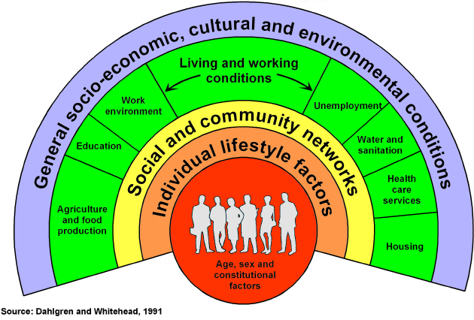
Notes:
This model on the slide, is the diagram that is typically used to describe what influences health. You can see in the centre individual, unchangeable factors e.g. age, sex, genetics, then outside of that is individual lifestyle factors, so this may be physical activity, diet, smoking. IN the yellow you can see social and community networks, now the social network someone has is known to influence health in many ways, from dictating the culture, health behaviours and social norms to providing the social support,. Then you get onto the wider living and working conditions before you reach the general socio-economic and cultural conditions, for example, a national or global recession will impact the health of an individual.
Public health considers all these influences on health and aims to improve the health of population groups by taking action on all these wider determinants. So it is very broad!

Slide 5
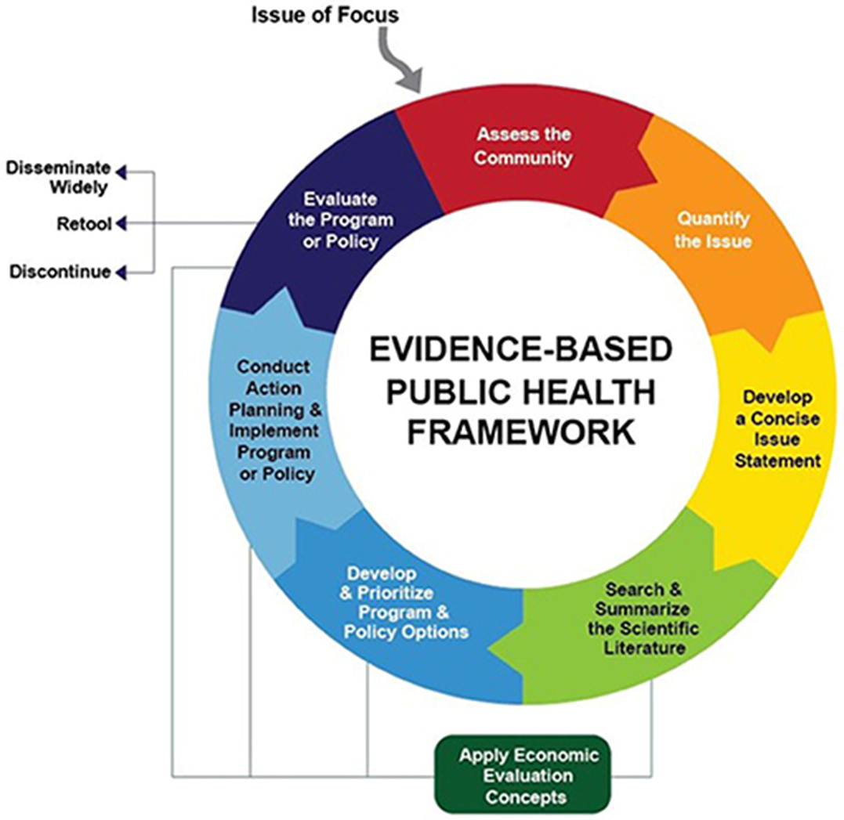
Notes:
The science of public health is Therefore, like in clinical medicine, when acting to improve population health, interventions should be based on evidence. When considering how to improve the health of your local population, it is therefore important to review all the evidence and data available on what is the health needs of the population, what is influencing the health of the population and what the effective interventions are for improving population health.
In public health, you are often responsible for the commissioning of services and interventions, and in a situation of limited funds, you have to also consider costs/benefits of any interventions and undertake prioritisation and rationalisation exercises, considering what you fund and whether you do it for the whole population or a certain group.
The art of public health, is doing this when the exact evidence is not available, which is often the case, as the impact of public health interventions is often very difficult to measure, unlike medical interventions where you examine if a drug has treated someones disease, public health intereventions for example creating a green space, may not have measurable health outcomes for many years to come e.g. reduction in metabolic disease due to reduced air pollution and increased physical activity.

Slide 6
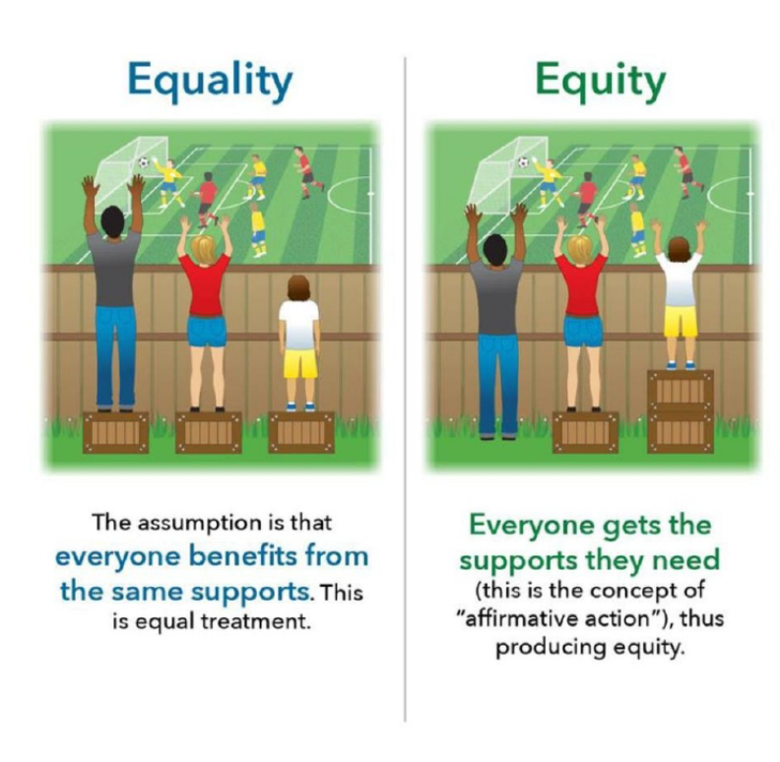
Tackling health inequities
Notes:
The final important aspect of public health I am going to introduce you to, is the concept of health inequities. Health inequities are unfair variations in health that are systemically produced, ie not the responsibility of the individual but due to the society in which they live. These variations in health can be due to any of the wider determinants of health I discussed earlier, with individuals having differing susceptibilities, environmental exposures, health behaviours, work/living environments and access to healthcare. One of the key aims of public health is not only to improve whole population health through ill health prevention and high-quality healthcare provision, but to tackle unfair differences in health outcomes between different groups of the population. Groups that often have worse outcomes, are those who are most deprived, migrant populations, ethnic minorities, individuals with special educational needs and so on.
The image on the screen shows that while giving every the same bike is often cheapest and enables the majority to cycle, it does not maximise the potential for all. The individual in the wheelchair cannot cycle at all, and the tall individual and small individual can cycle, but not to the best of their ability as the bike is not the right size. In the underneath image, it recognises to get the best out of everyone, we need to ficeTackling health inequalities, often requires greater resource being given to those who suffer them. For example in the picture on the slide, if we give everyone the same, the shortest person cannot see the football match, whereas, if we give proportionate resource to need, then we can tackle the unfair difference.
Often with resource allocation decisions, public health specialists have to balance equity and efficiency. It is frequently more efficient, providing the greatest benefit to the whole population within limited resources, to improve the health and healthcare services for easy to access populations e.g. through national campaigns. However, such descions tend to widen health inequalities, with certain population groups for example ethnic minorities, or those who are most deprived continuing to have very low engagement with health services and therefore worse outcomes. Public health specialist are expert in identifying and addressing health inequalities while also balancing out efficiency and equity.

Slide 7
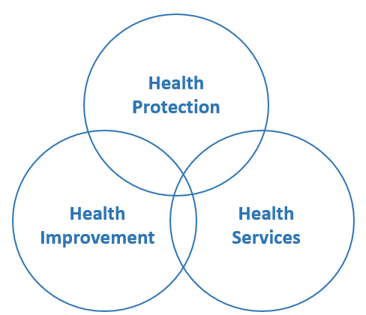
Domains of public health

Slide 8
Summary – What is public health?
Working to improve population health
Considering the wider determinants of health
Experts in analysing evidence (data and research) and applying it
Focus on tackling health inequities

